Slide 1
DSB Teacher Guide

Slide 2
1. Setting up your account

Slide 3
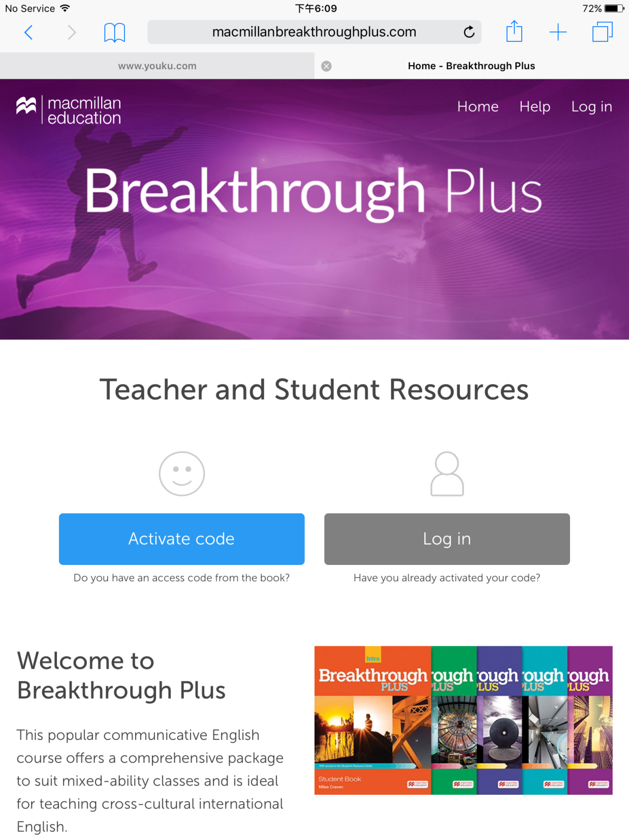
Go to www.macmillanbreakthroughplus.com

Slide 4
Click:
Activate code

Slide 5
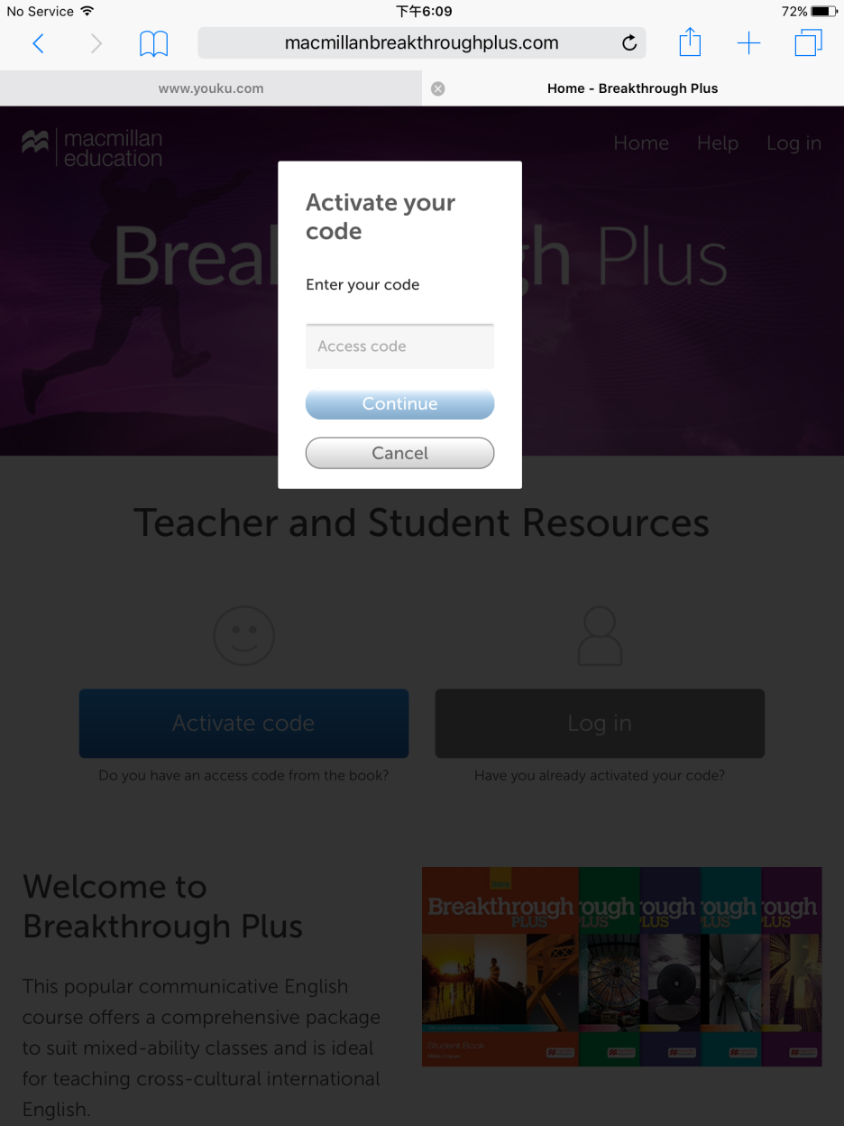
Enter the activation code e.g. BTP12345566789

Slide 6
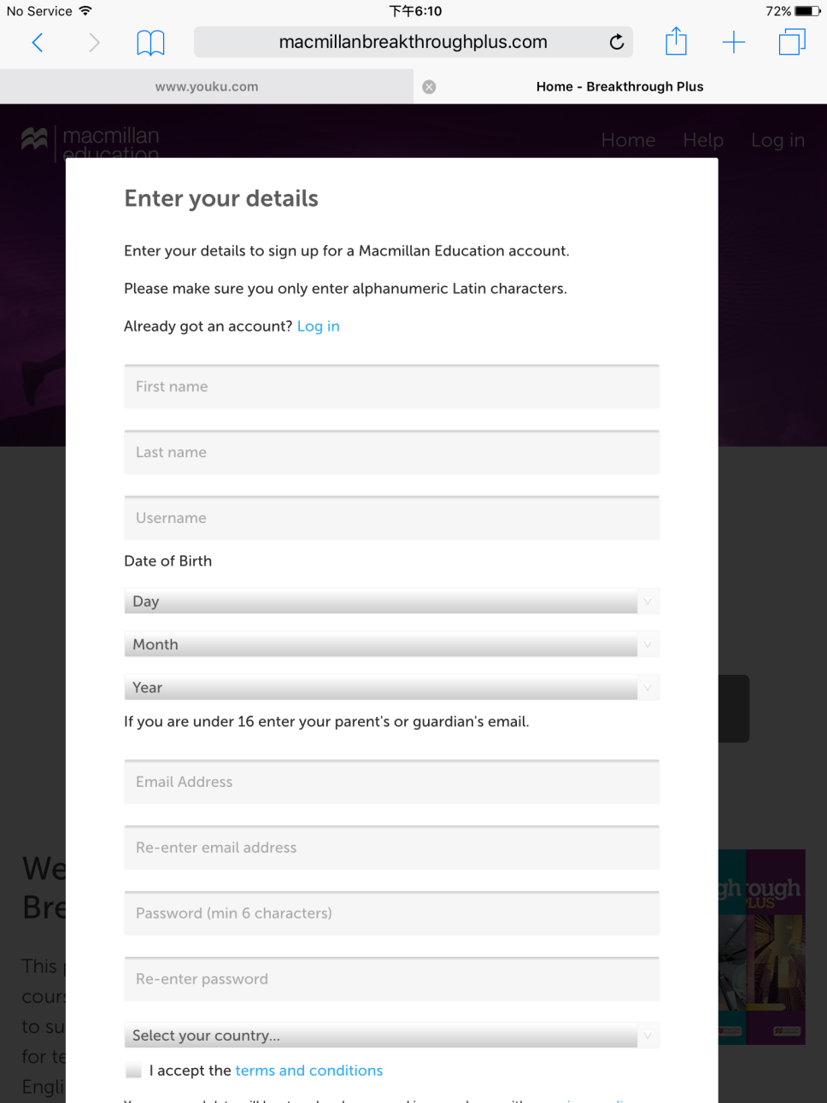
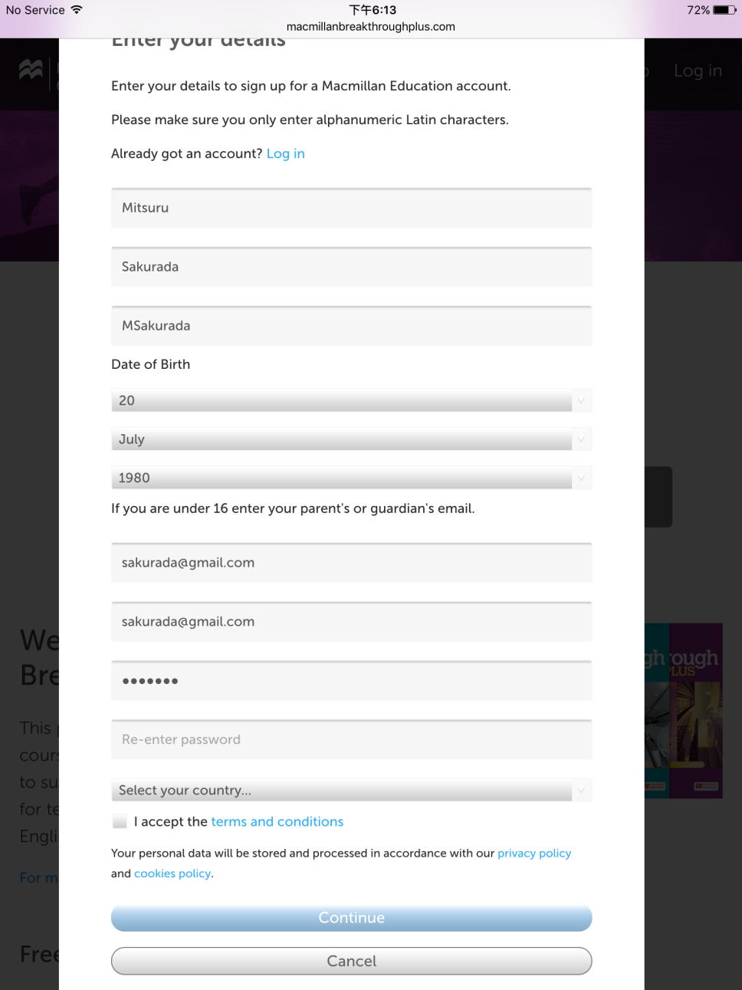
Enter your personal details
Write down your username and password and keep it safe
Tick the Terms and Conditions box and click: Continue

Slide 7
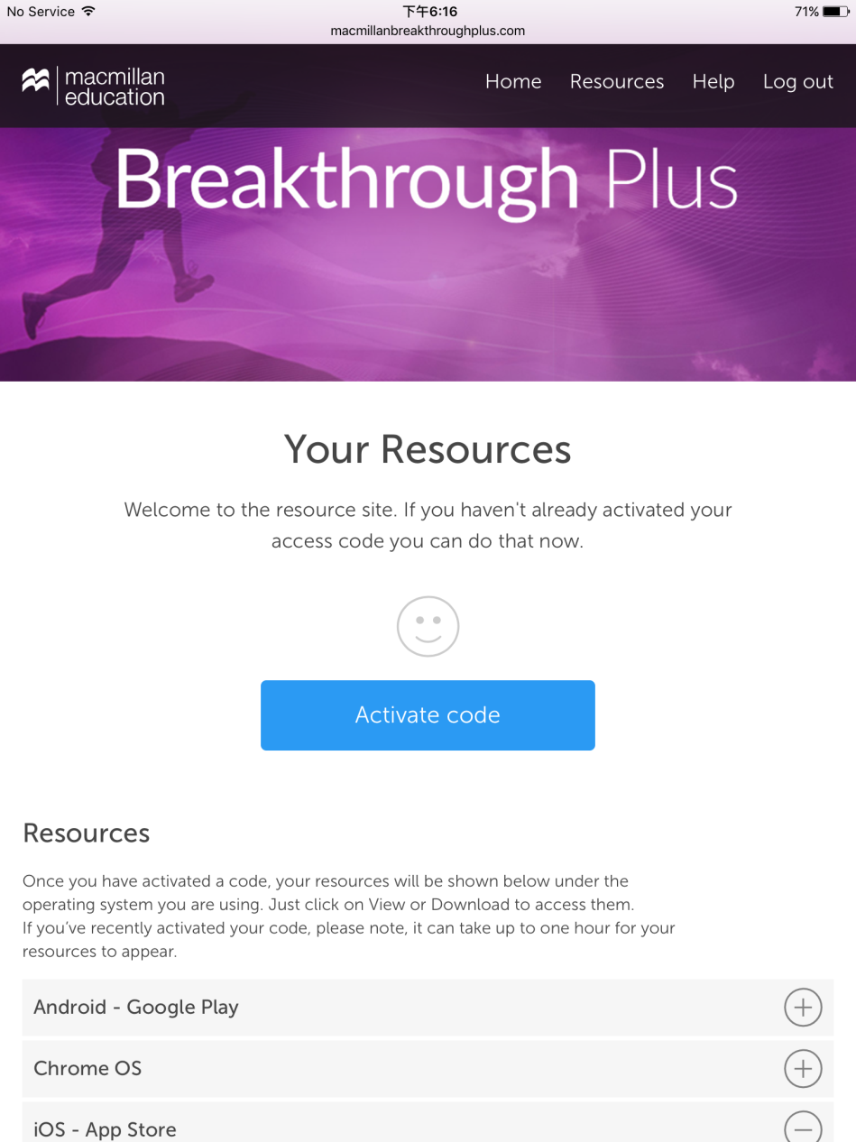
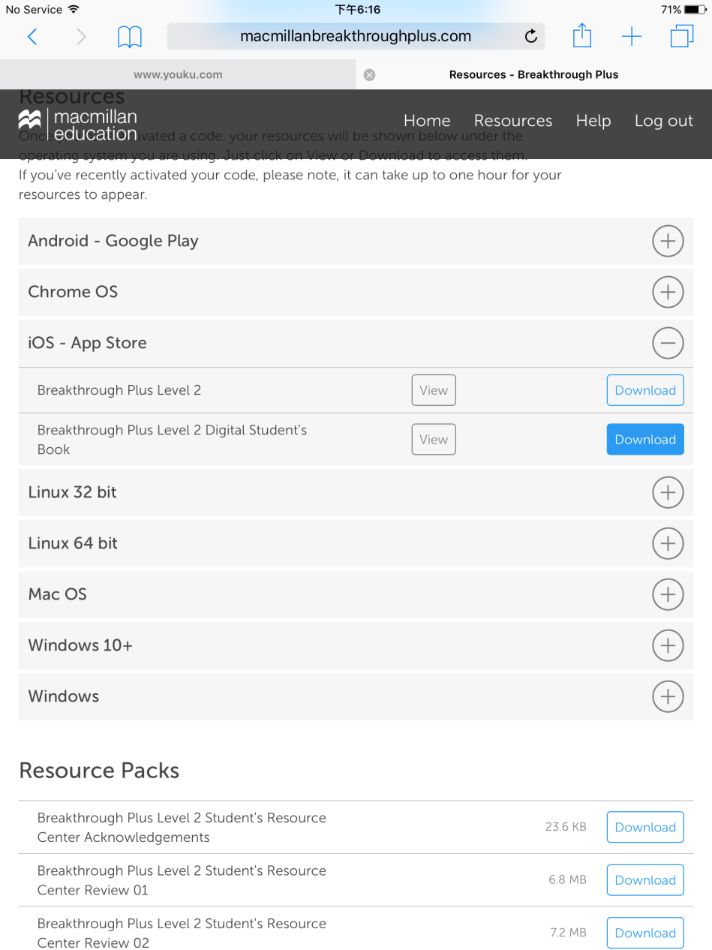
You will be taken to this page. Click on the button next to iOS – App Store
Click: Download next to Breakthrough Plus Level X Digital Student’s Book

Slide 8
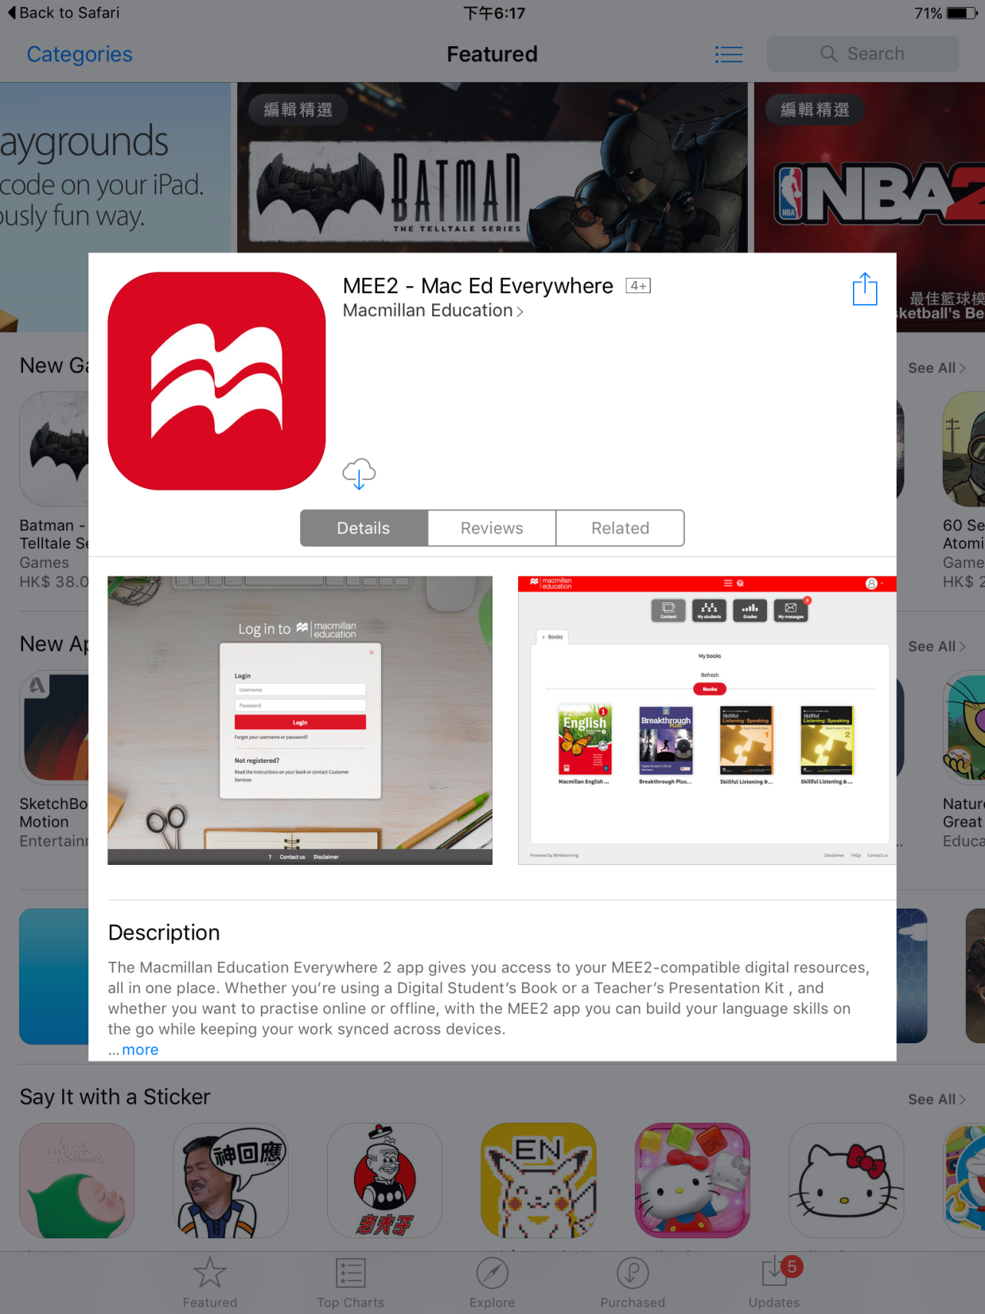
You will be taken to the App Store. Click on the download button.

Slide 9
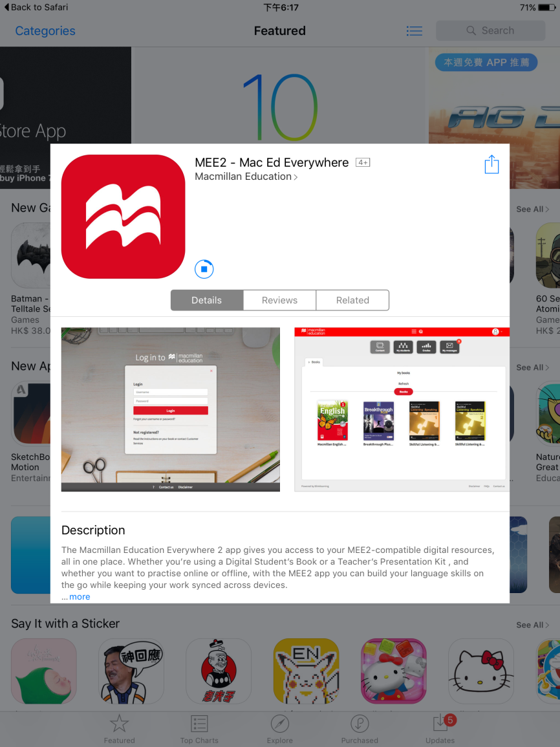
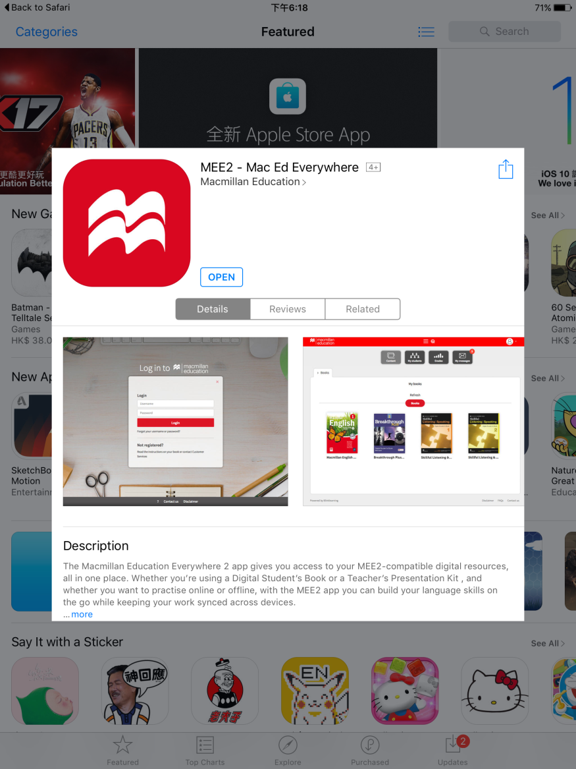
Once it has finished downloading, click: open

Slide 10
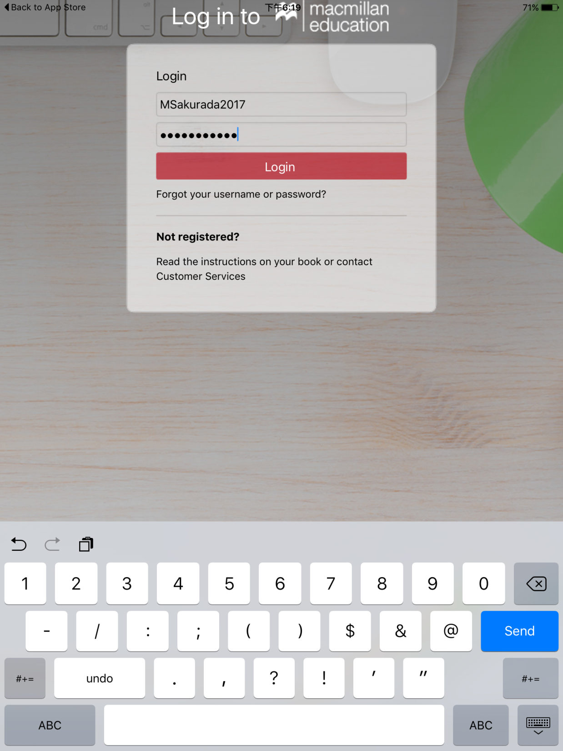
Enter your username and password that you registered with earlier. Click: login

Slide 11
2. Creating a class

Slide 12
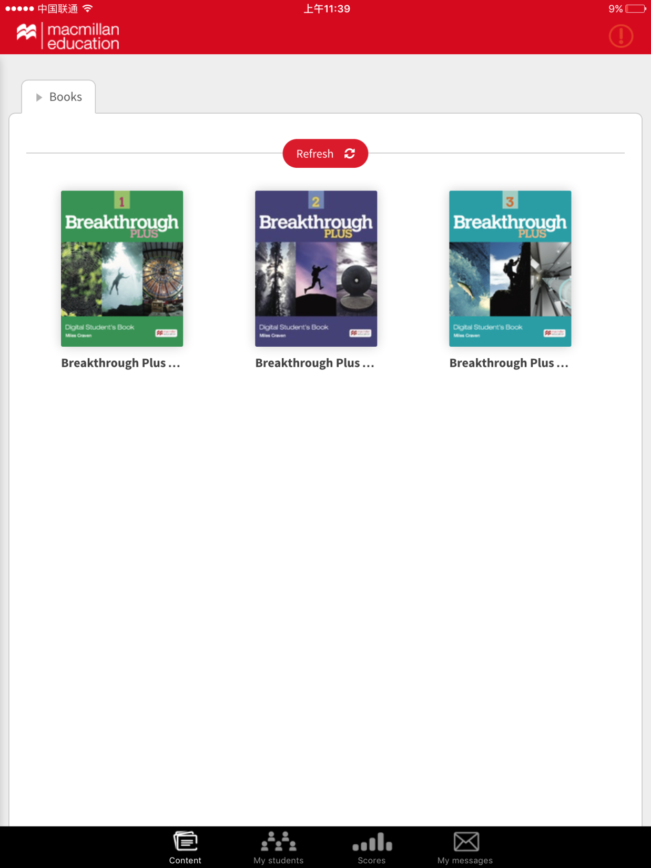
Click: My Students

Slide 13
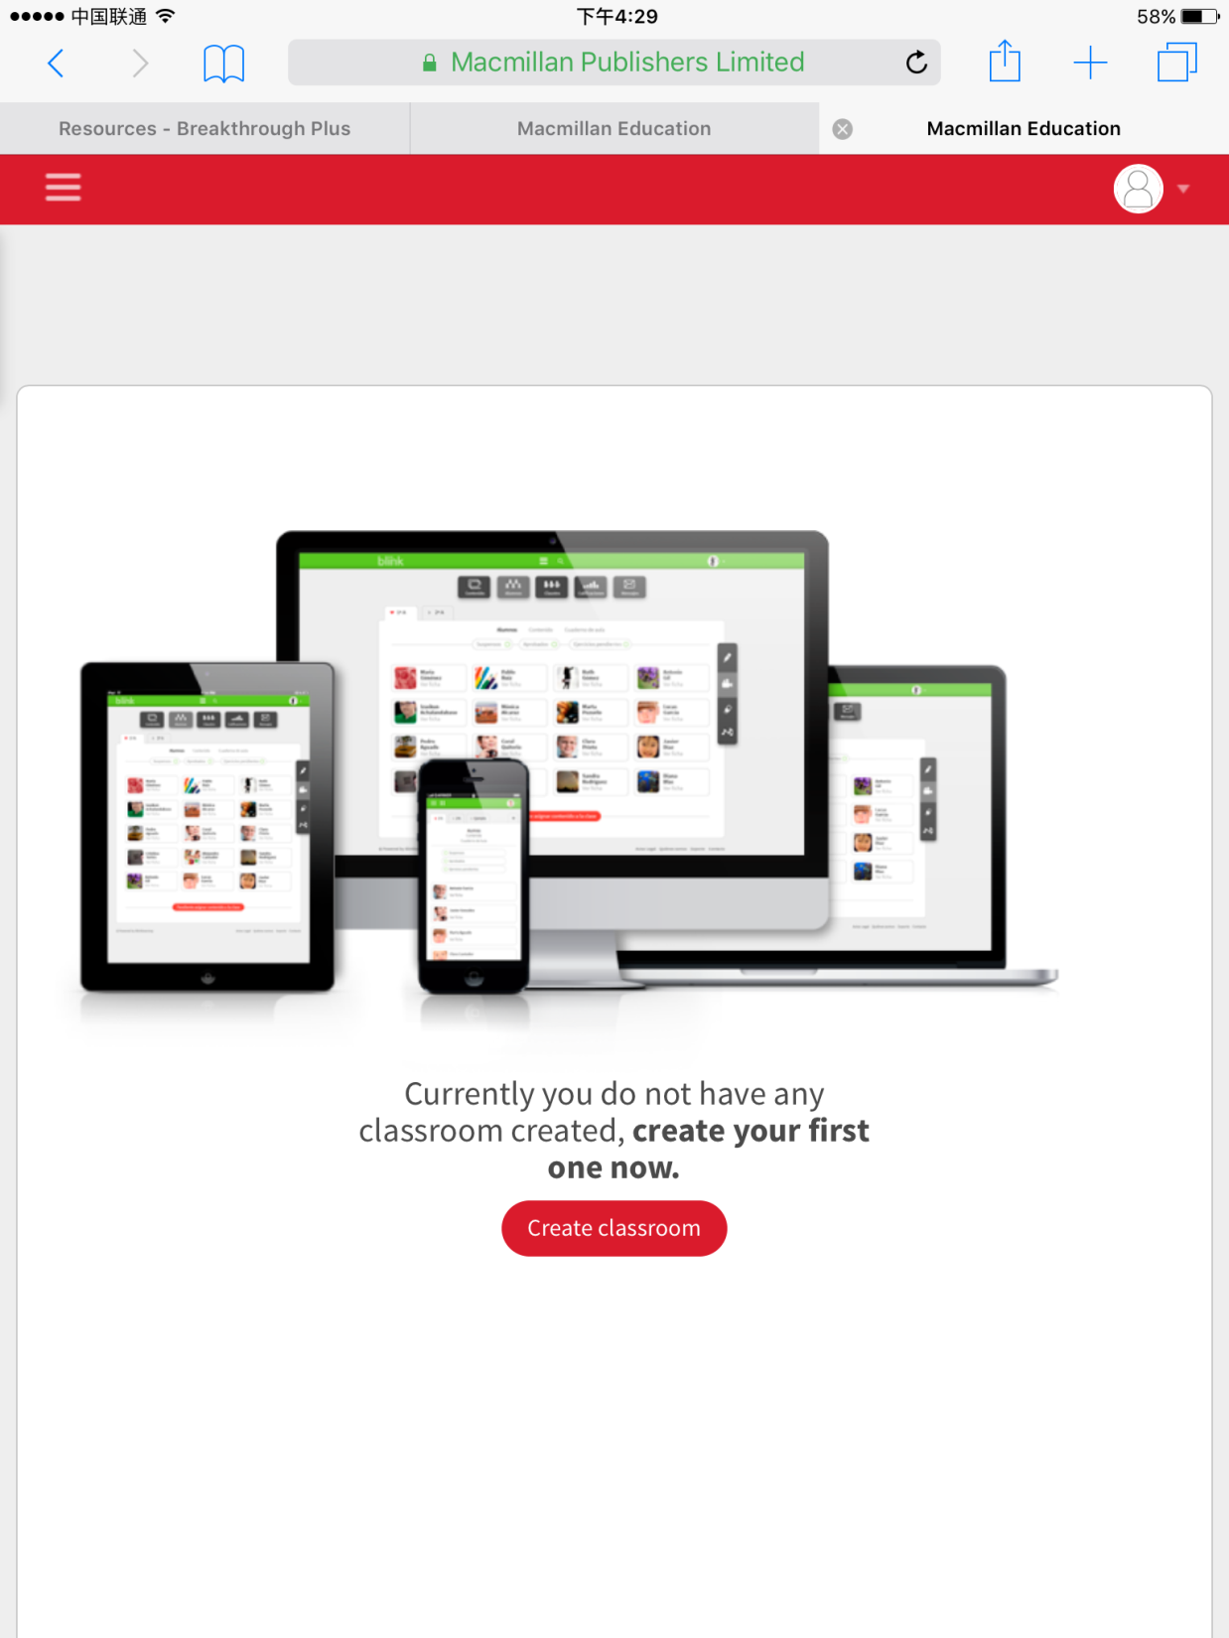
Click: Create classroom and enter the details for the classroom

Slide 14
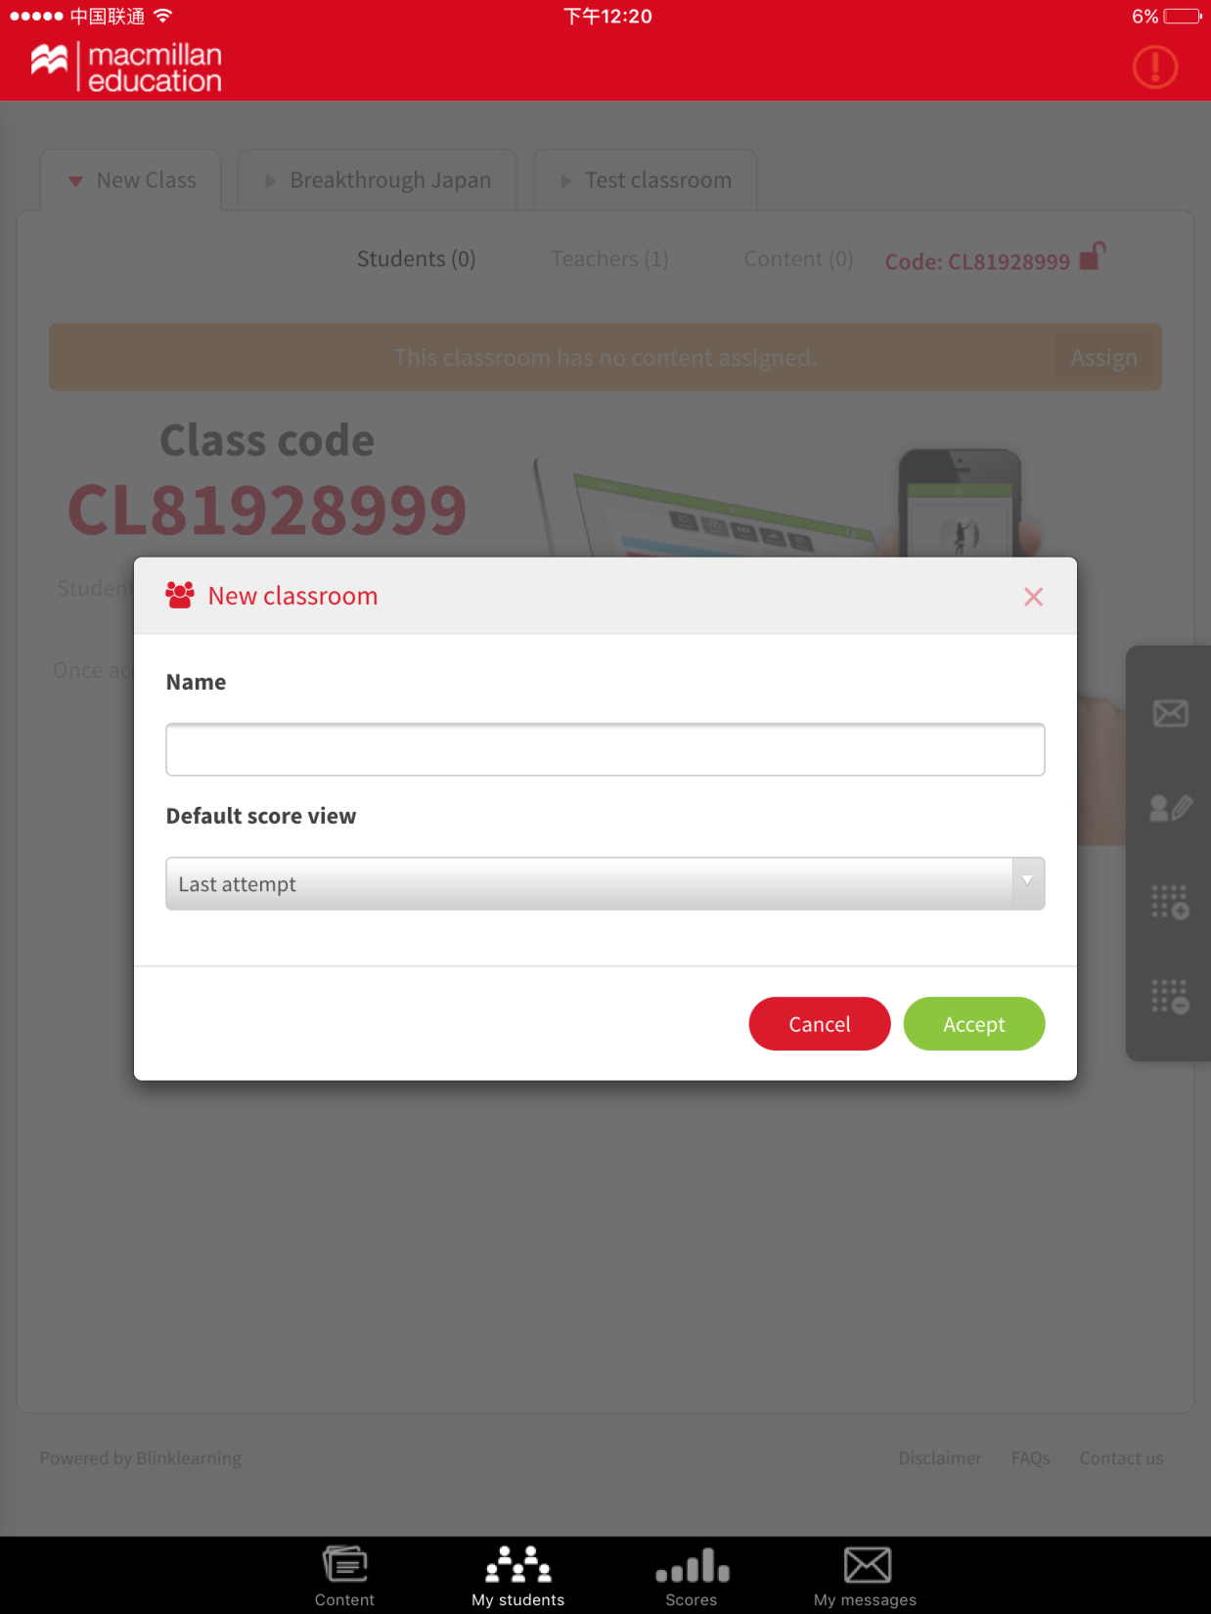
Enter the name for the class and select the default score view. Click: accept

Slide 15
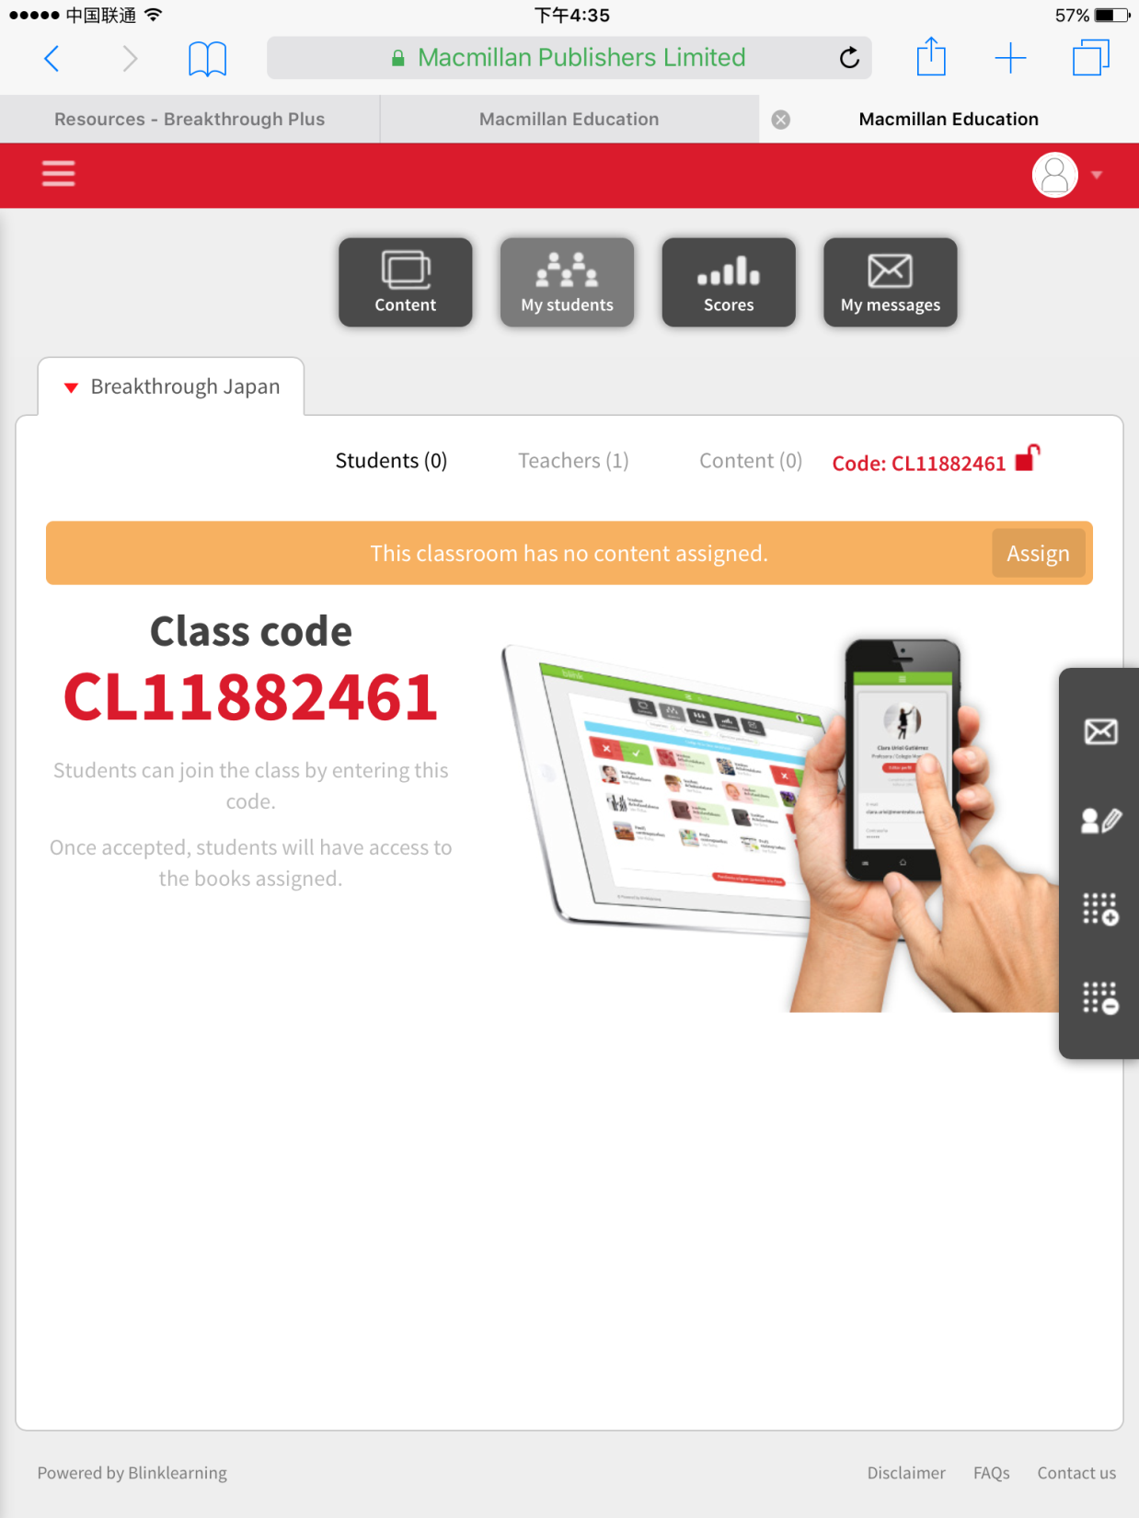
Click: Assign to assign a course to the classroom
Provide the class code to your students for them to enter on their account (see Student DSB walkthrough)

Slide 16
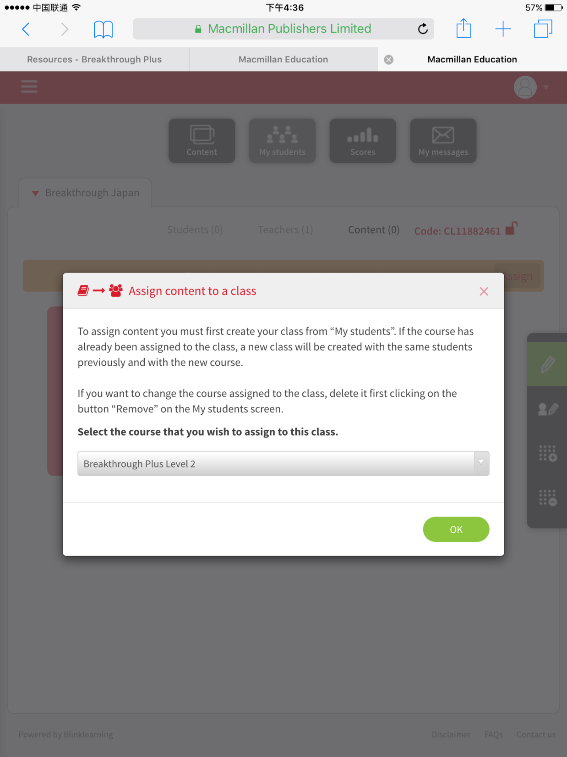
Select the course that you wish to assign to the class

Slide 17
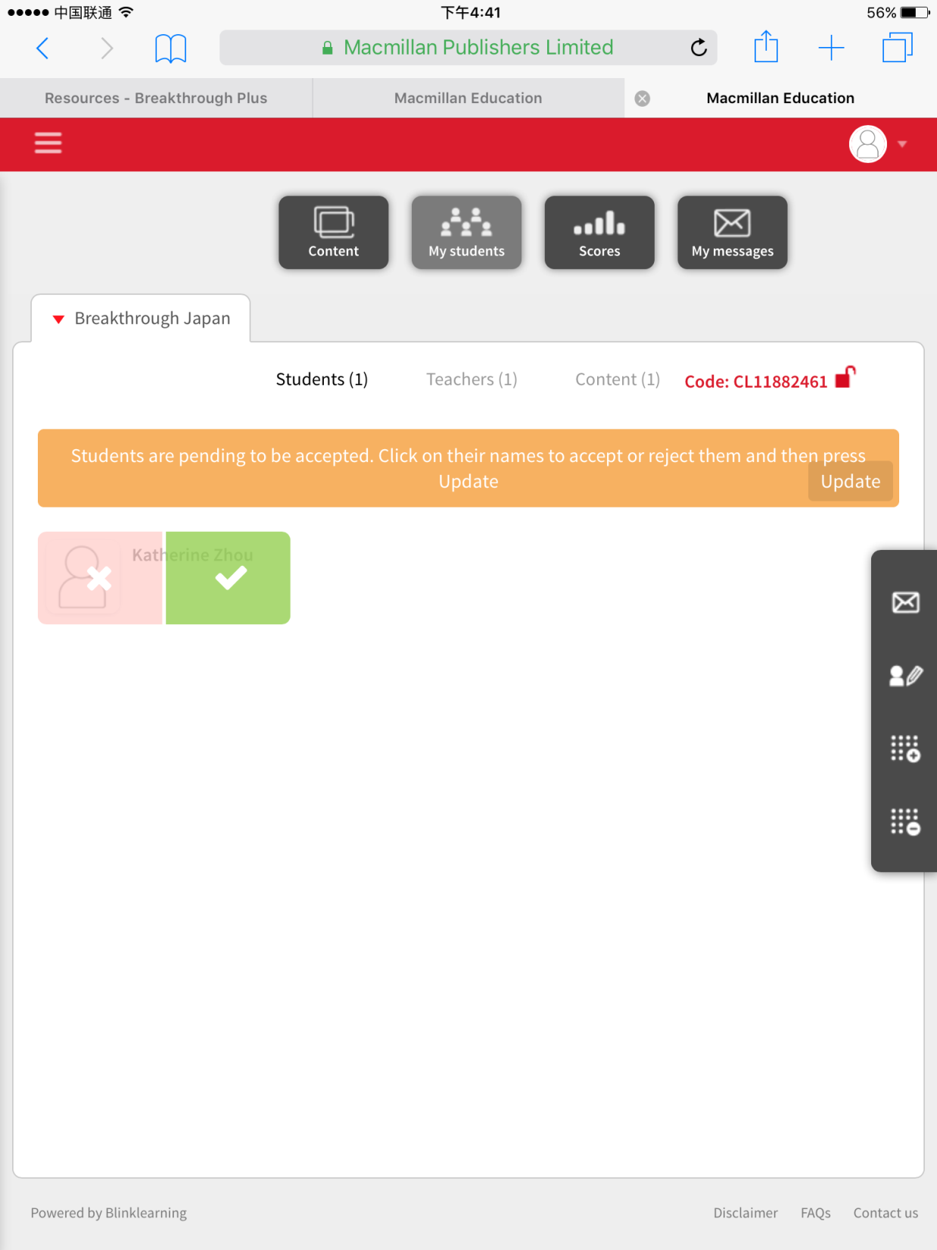
Remember you need to provide the class code to your students for them to join your class (see Student DSB walkthrough)
Once your students have entered the class code on their account, click: tick to accept students into your class

Slide 18
Classroom tools can be found on the right hand side of the screen
Function | Tool icon
Send a message to the whole class
Edit the classroom
Create a new class
Delete an existing class

Slide 19
3. Working with the Digital Student’s Book

Slide 20
Click: Content to access the DSB

Slide 21
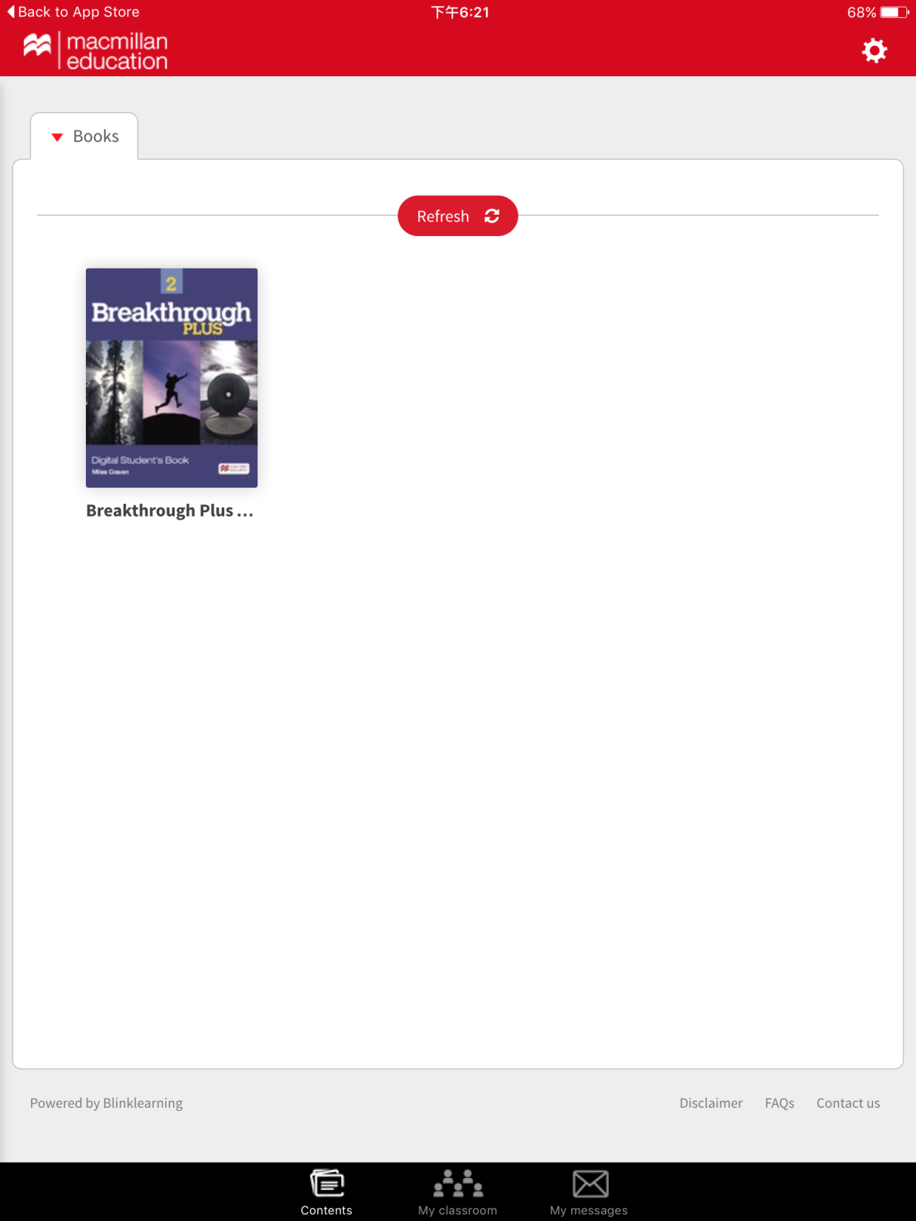
Click on the book

Slide 22
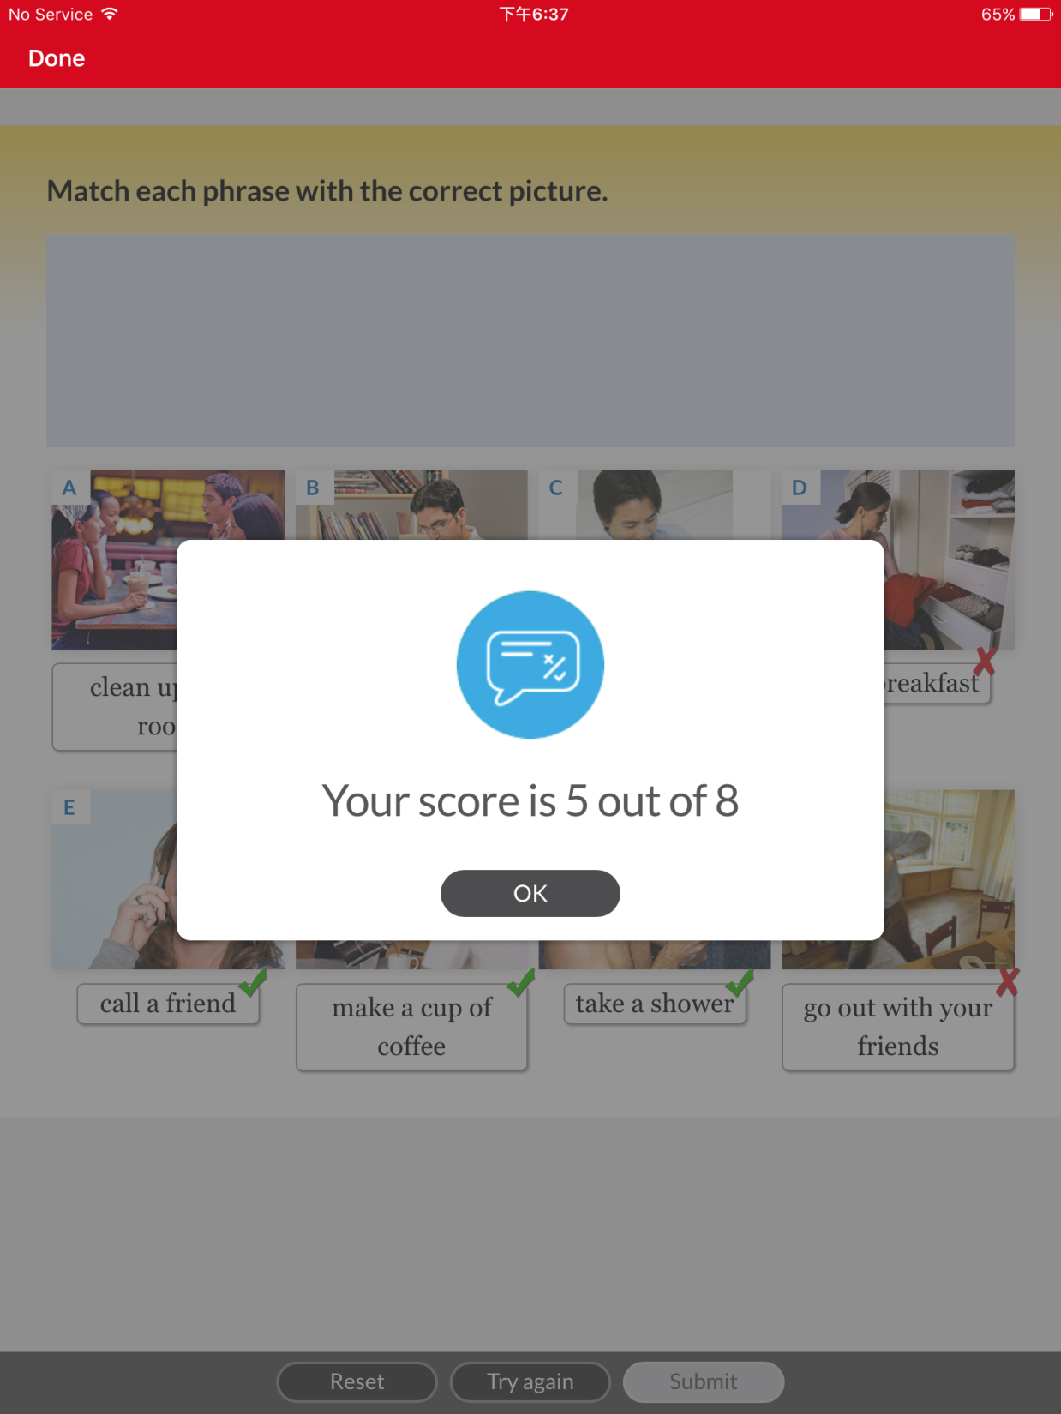
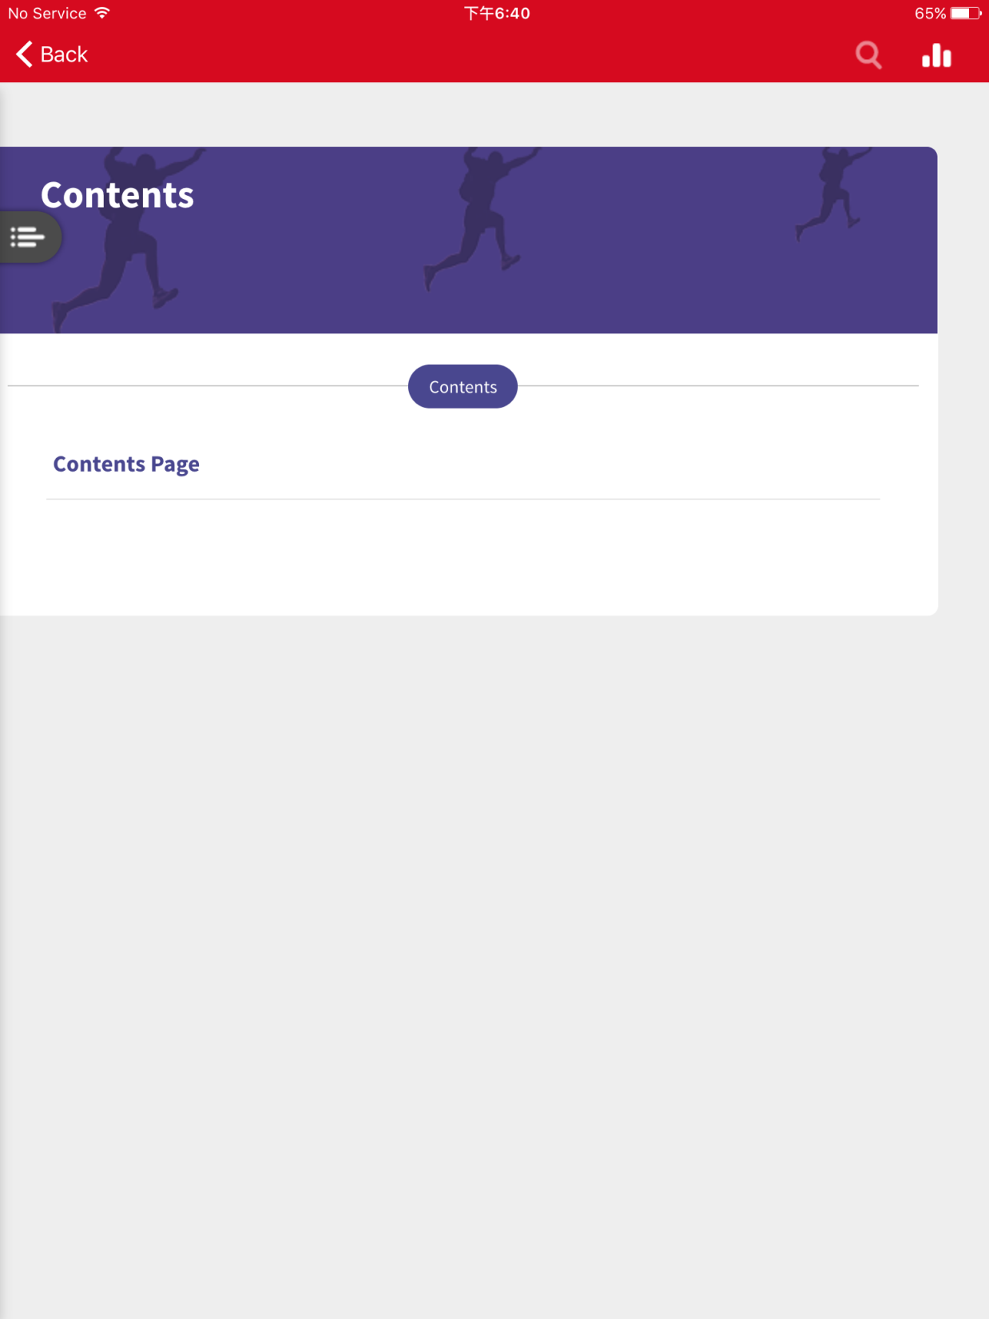
Click on this button

Slide 23
Click on a chapter from the contents

Slide 24
Turn the pages by swiping

Slide 25
Click on the buttons to listen to the conversations and do the activities

Slide 26
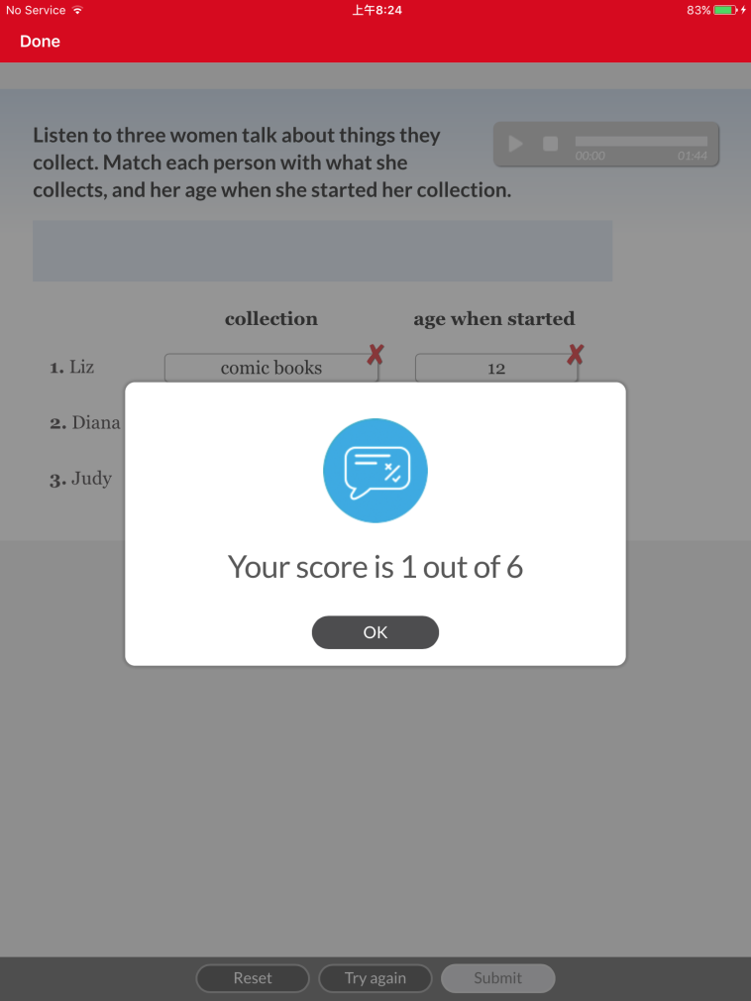
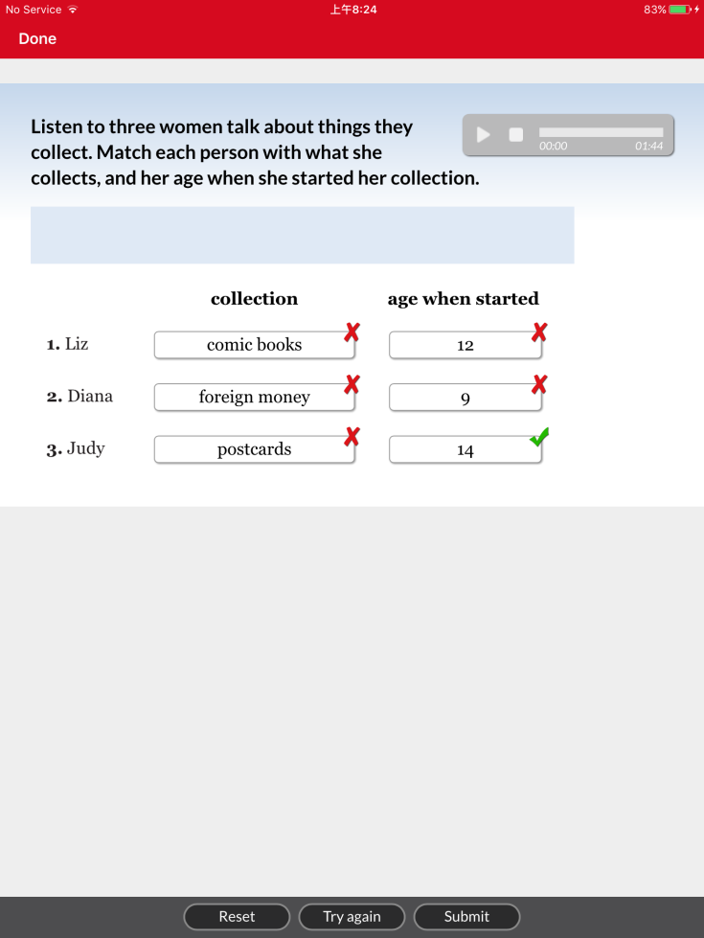
Complete the exercise and click on submit to see the score
You can reset or try again

Slide 27
Click on the button to watch the video

Slide 28
DSB Tools can be found at the top of the screen
Function | Tool icon
Pen: draw/annotate
Hotspot: Open activities e.g. audio, videos, writing tasks
Highlighter: Highlight text
Text: Underline/strike text, free text, annotations, block out text
Resources: Access resources in one place e.g. exercises, multimedia and documents
Annotations: Access annotations in one place
Search: Search for words/phrases in the book
Navigation: Skip to another page in the book

Slide 29
4. Viewing students’ scores

Slide 30
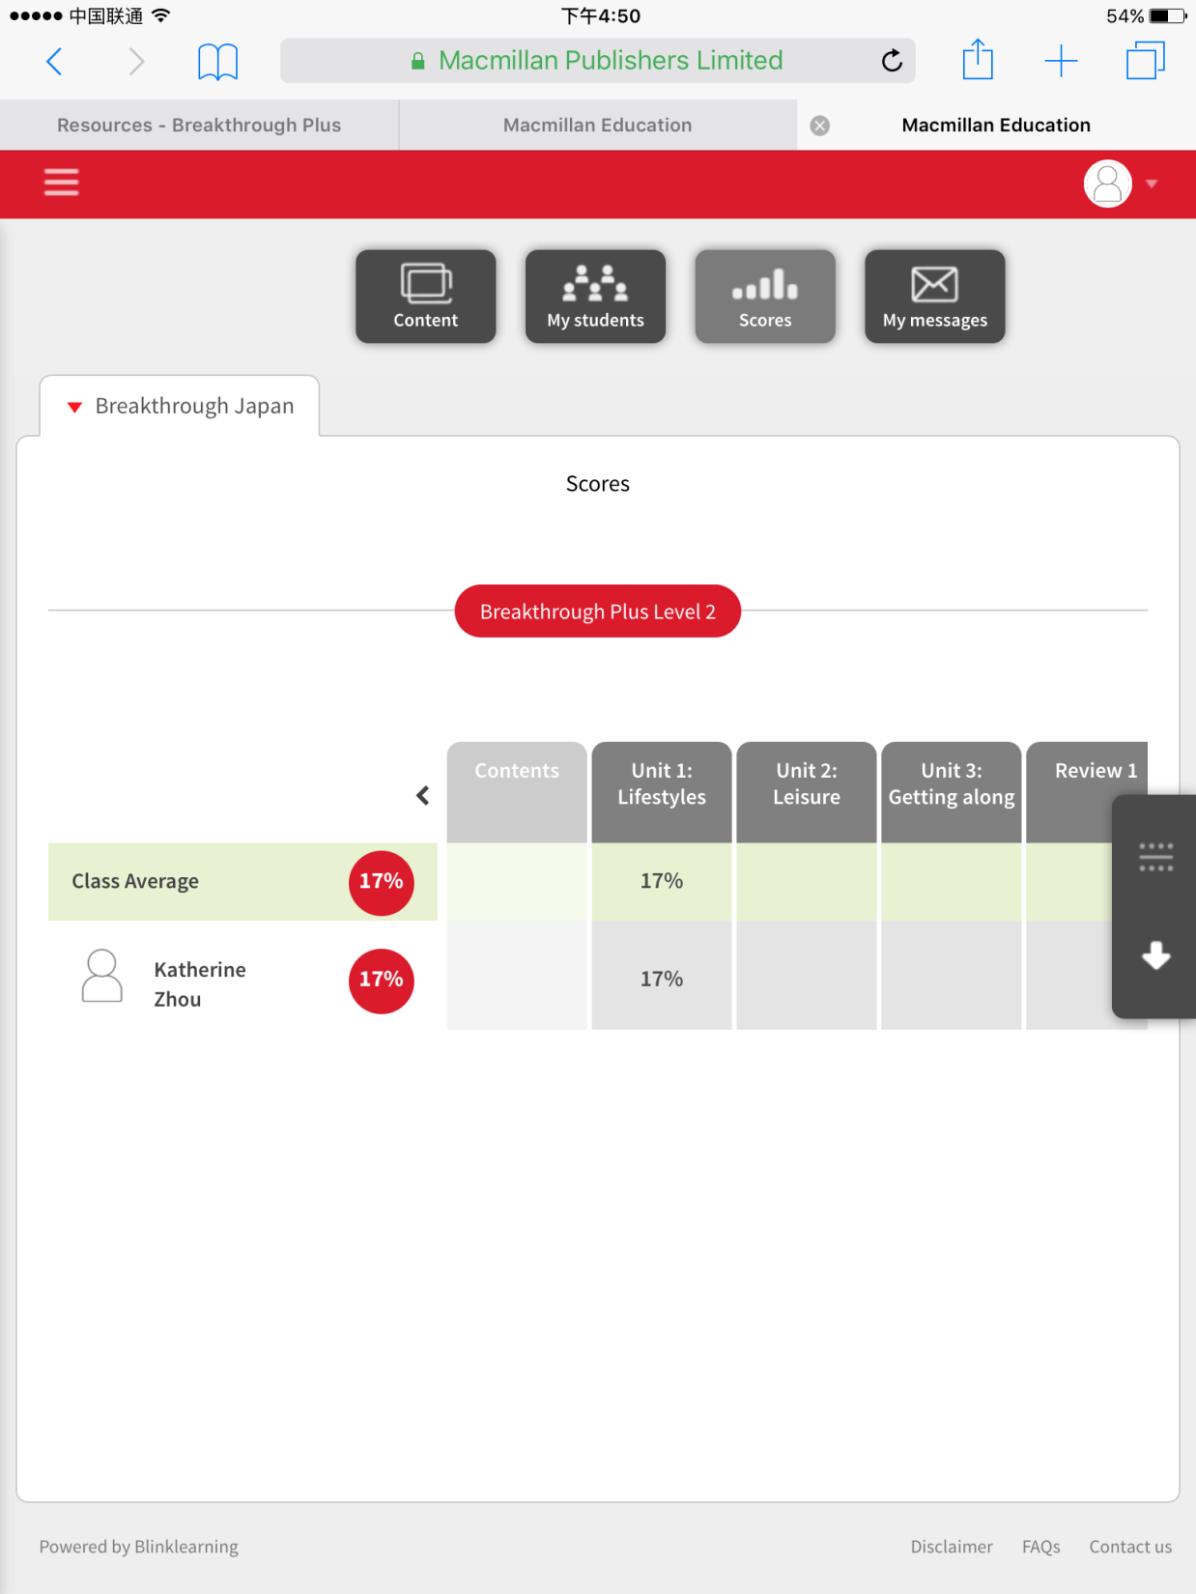
Click: Scores to see your students’ scores
Click the arrow to view scores in a document
Click: Each student to see their scores

Slide 31
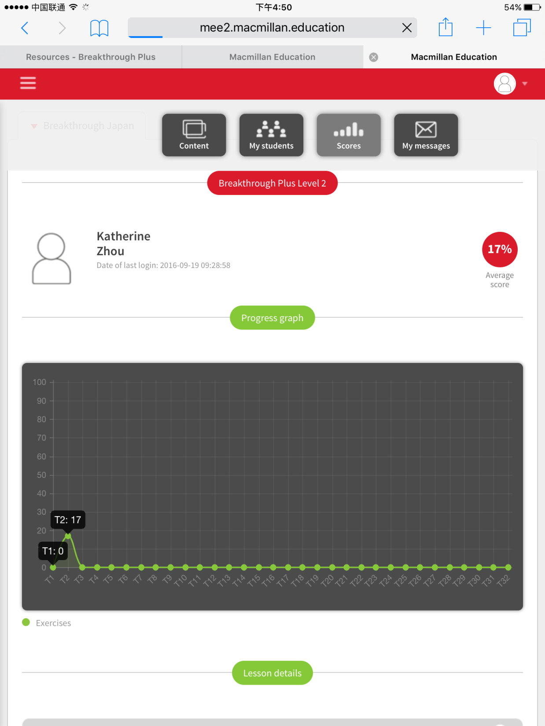
This is the student’s average score
You can view the progress of your students

Slide 32
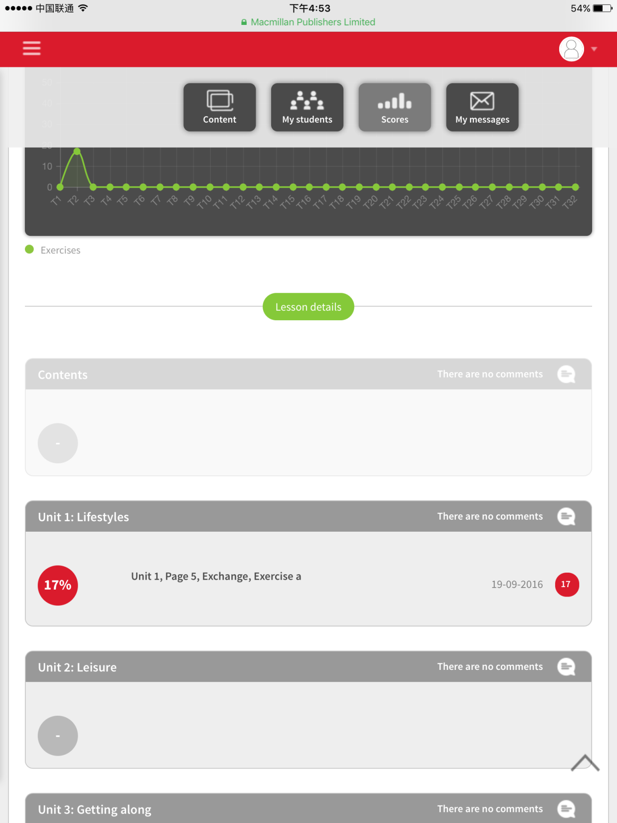
You can view the scores for each unit, and leave comments

Slide 33
5. Sending messages to your students

Slide 34
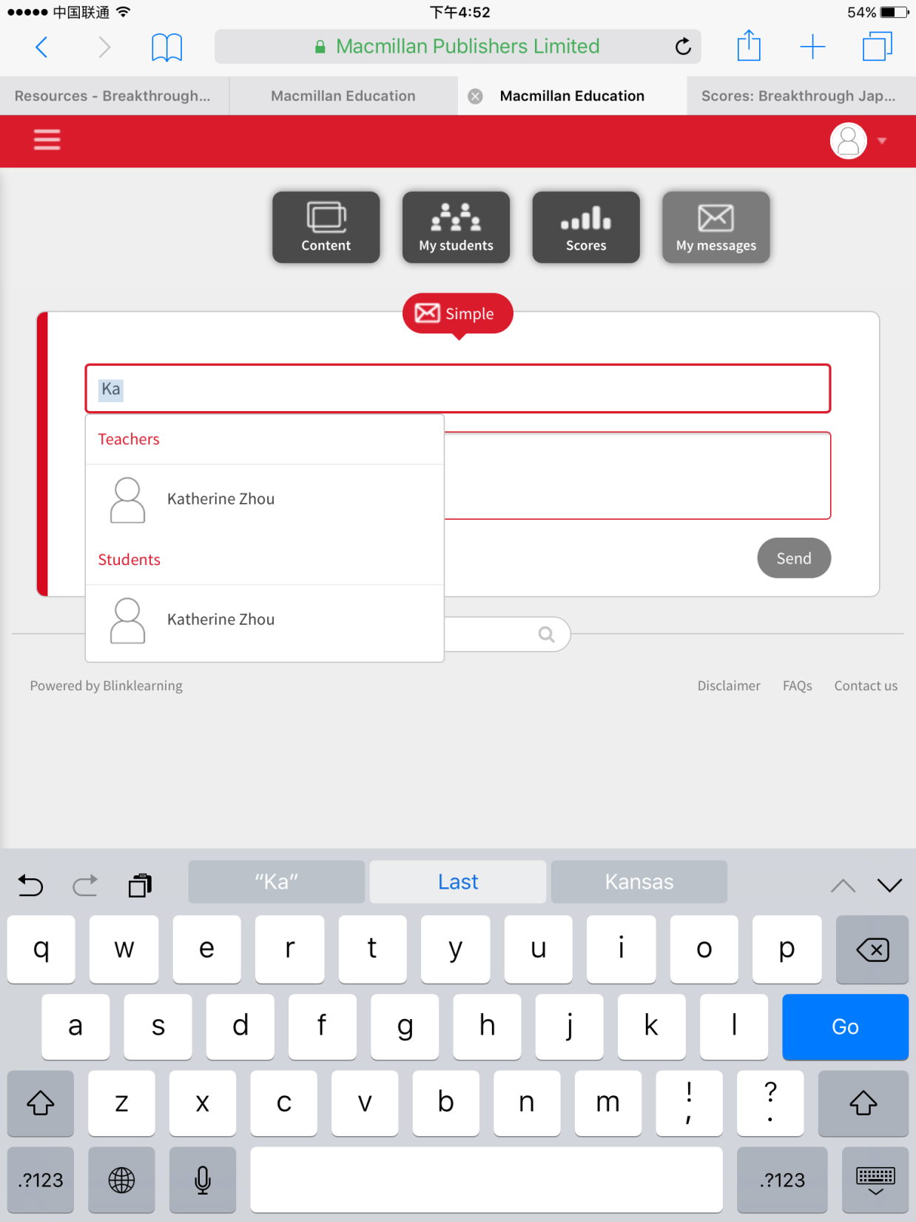
Click: My messages to send a message to your student
Enter the name of the student(s) and the message, then click: send

Slide 35
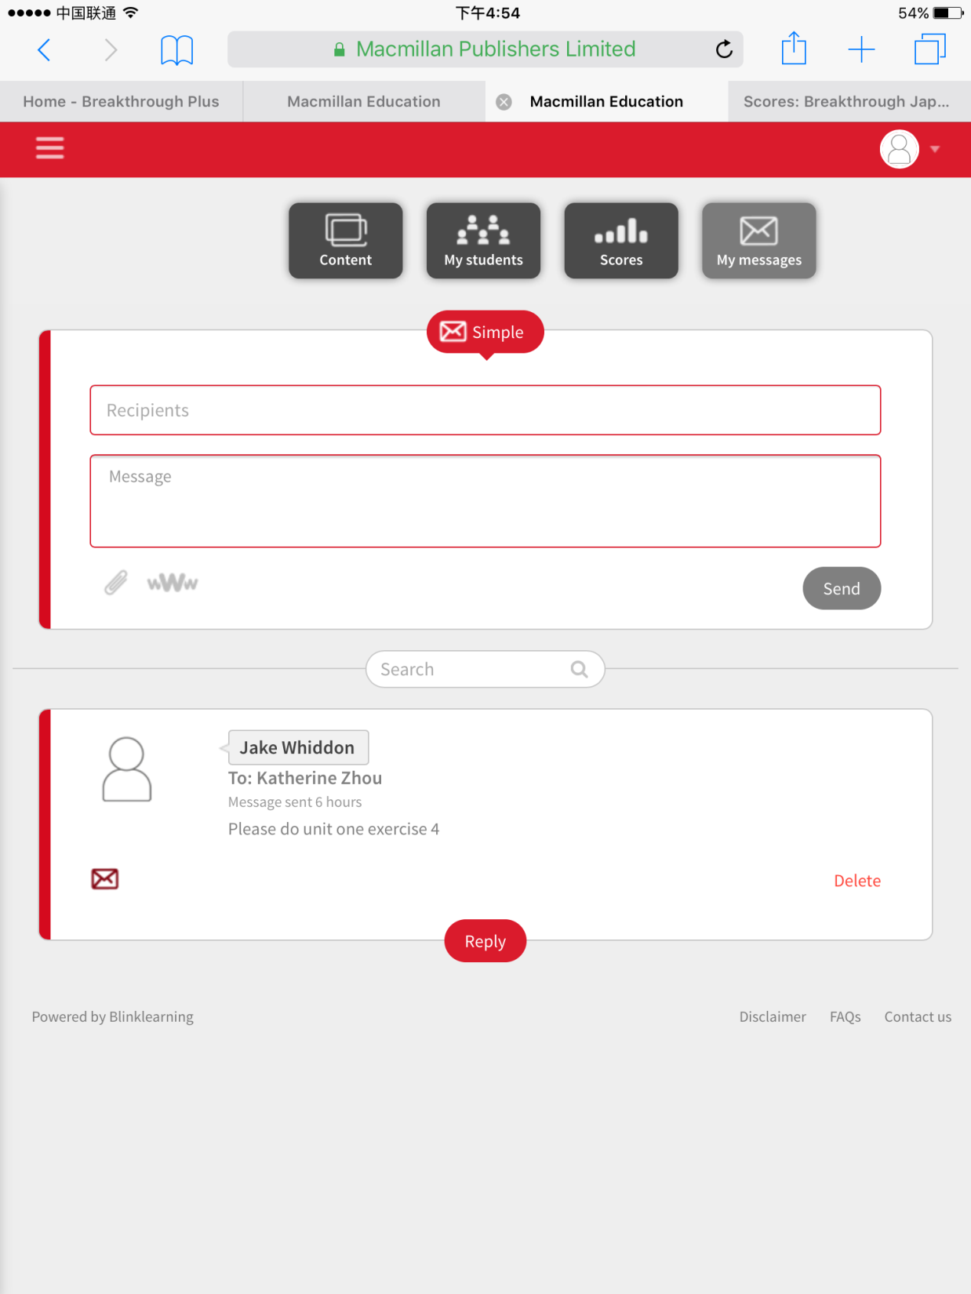
You will see your sent message here.

Slide 36
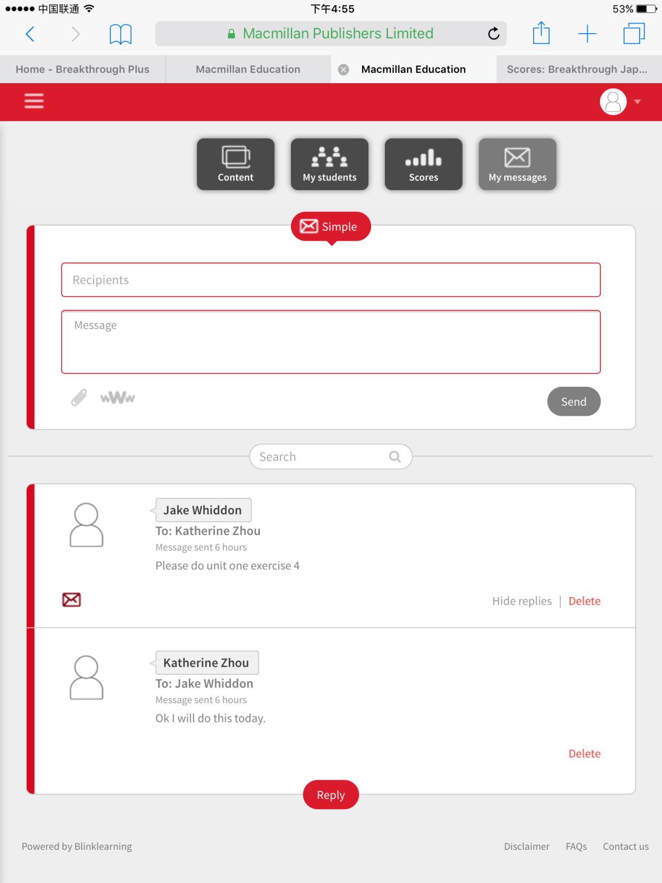
You will see replies from the student here
Click: reply to reply to your student’s message

