Slide 1
DSB Student Guide

Slide 2
1. Setting up your account and joining a class

Slide 3
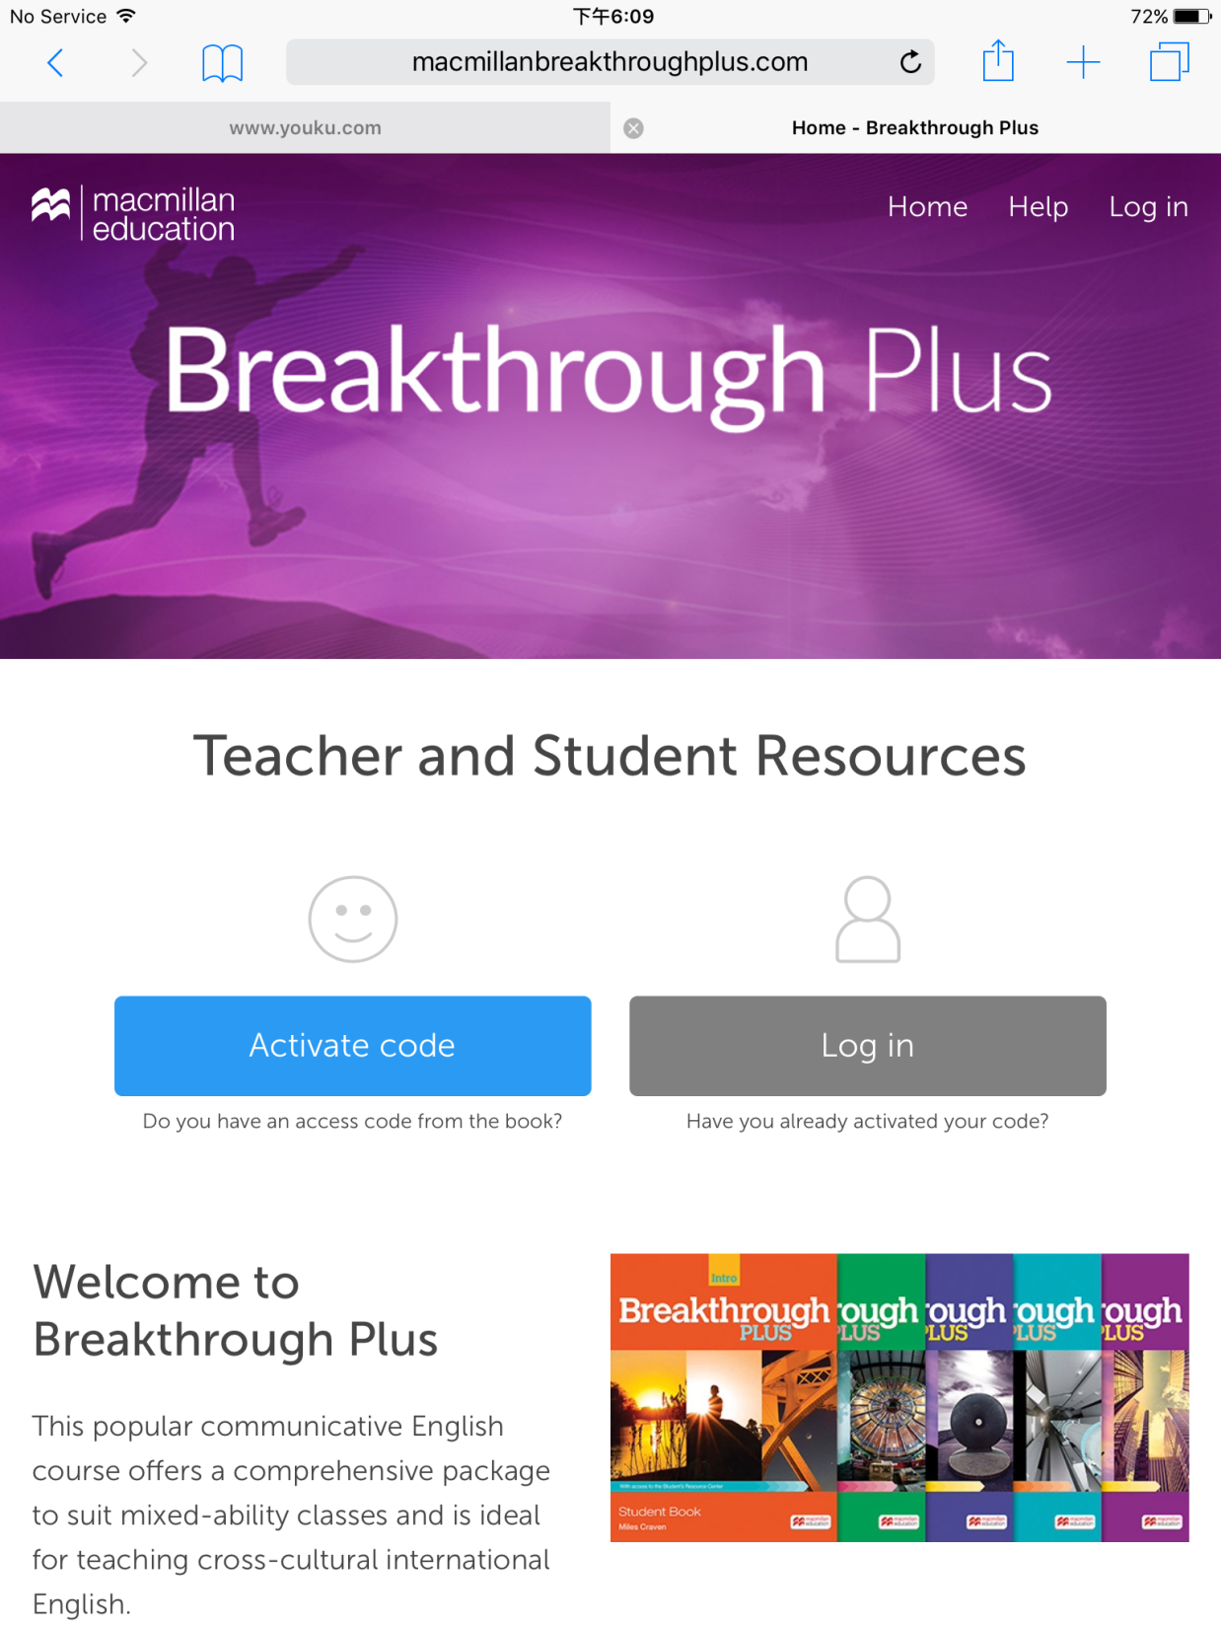
Go to www.macmillanbreakthroughplus.com

Slide 4
Click:
Activate code

Slide 5
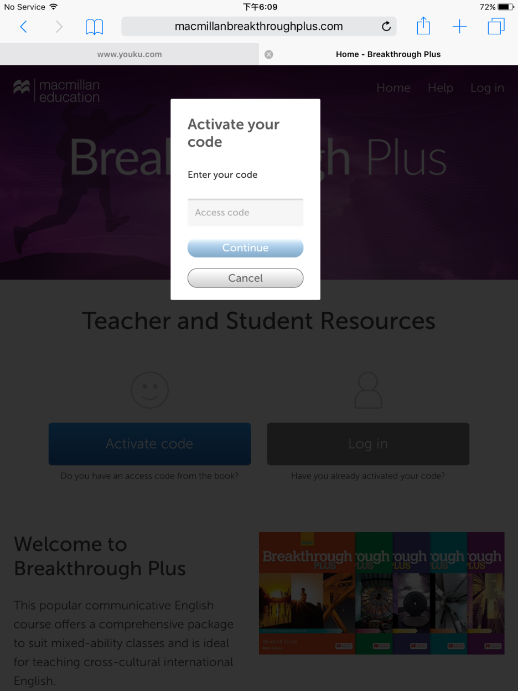
Enter the activation code your teacher gave you
e.g. BTP12345566789

Slide 6
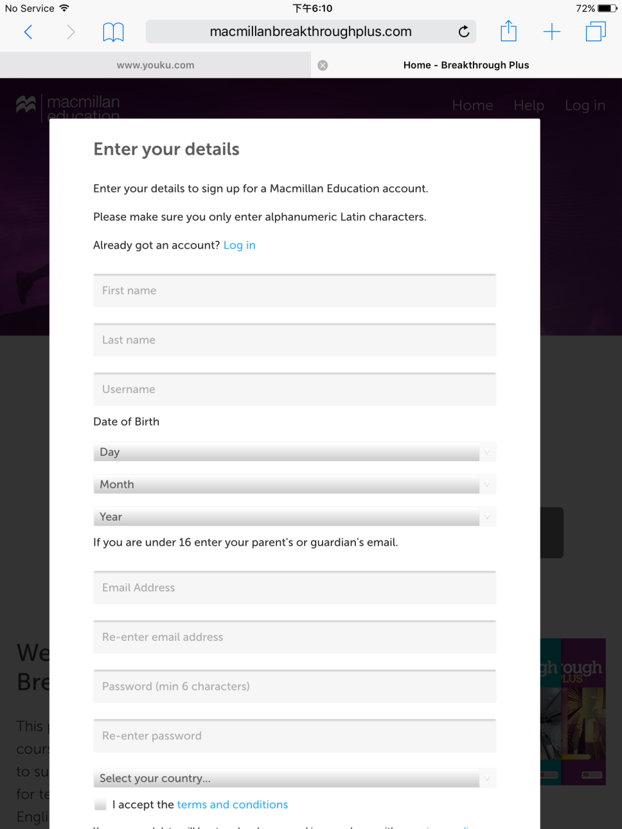
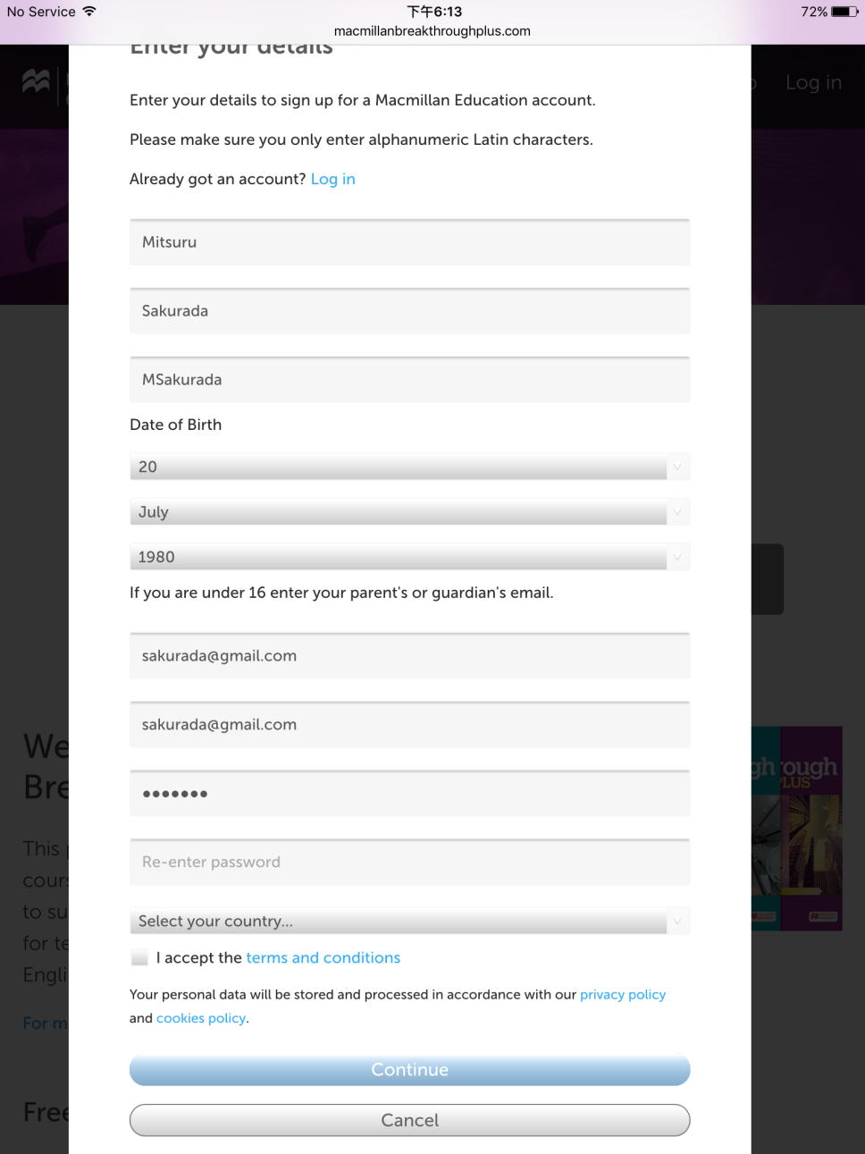
Enter your personal details
Write down your username and password and keep it safe
Tick the Terms and Conditions box and click: Continue

Slide 7
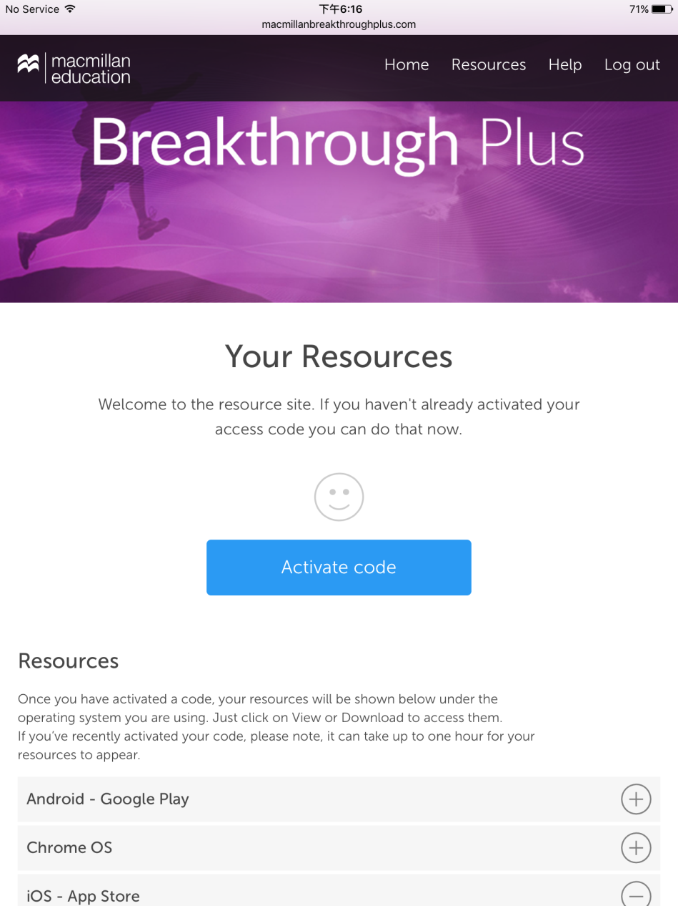
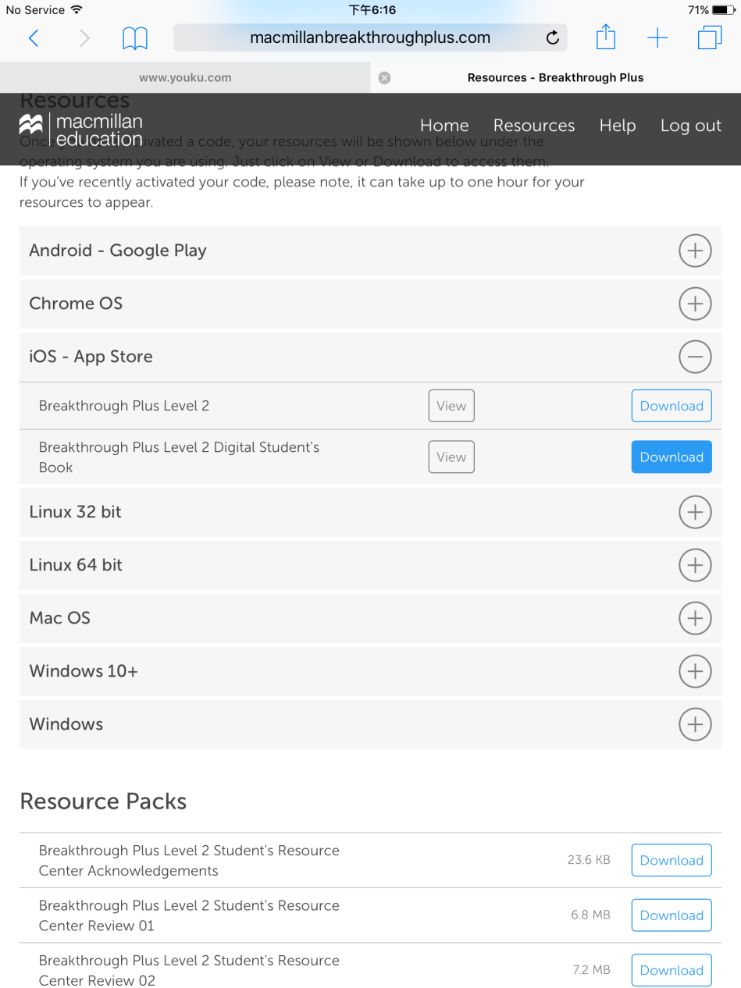
You will be taken to this page. Click on the button next to iOS – App Store
Click: Download next to Breakthrough Plus Level X Digital Student’s Book

Slide 8
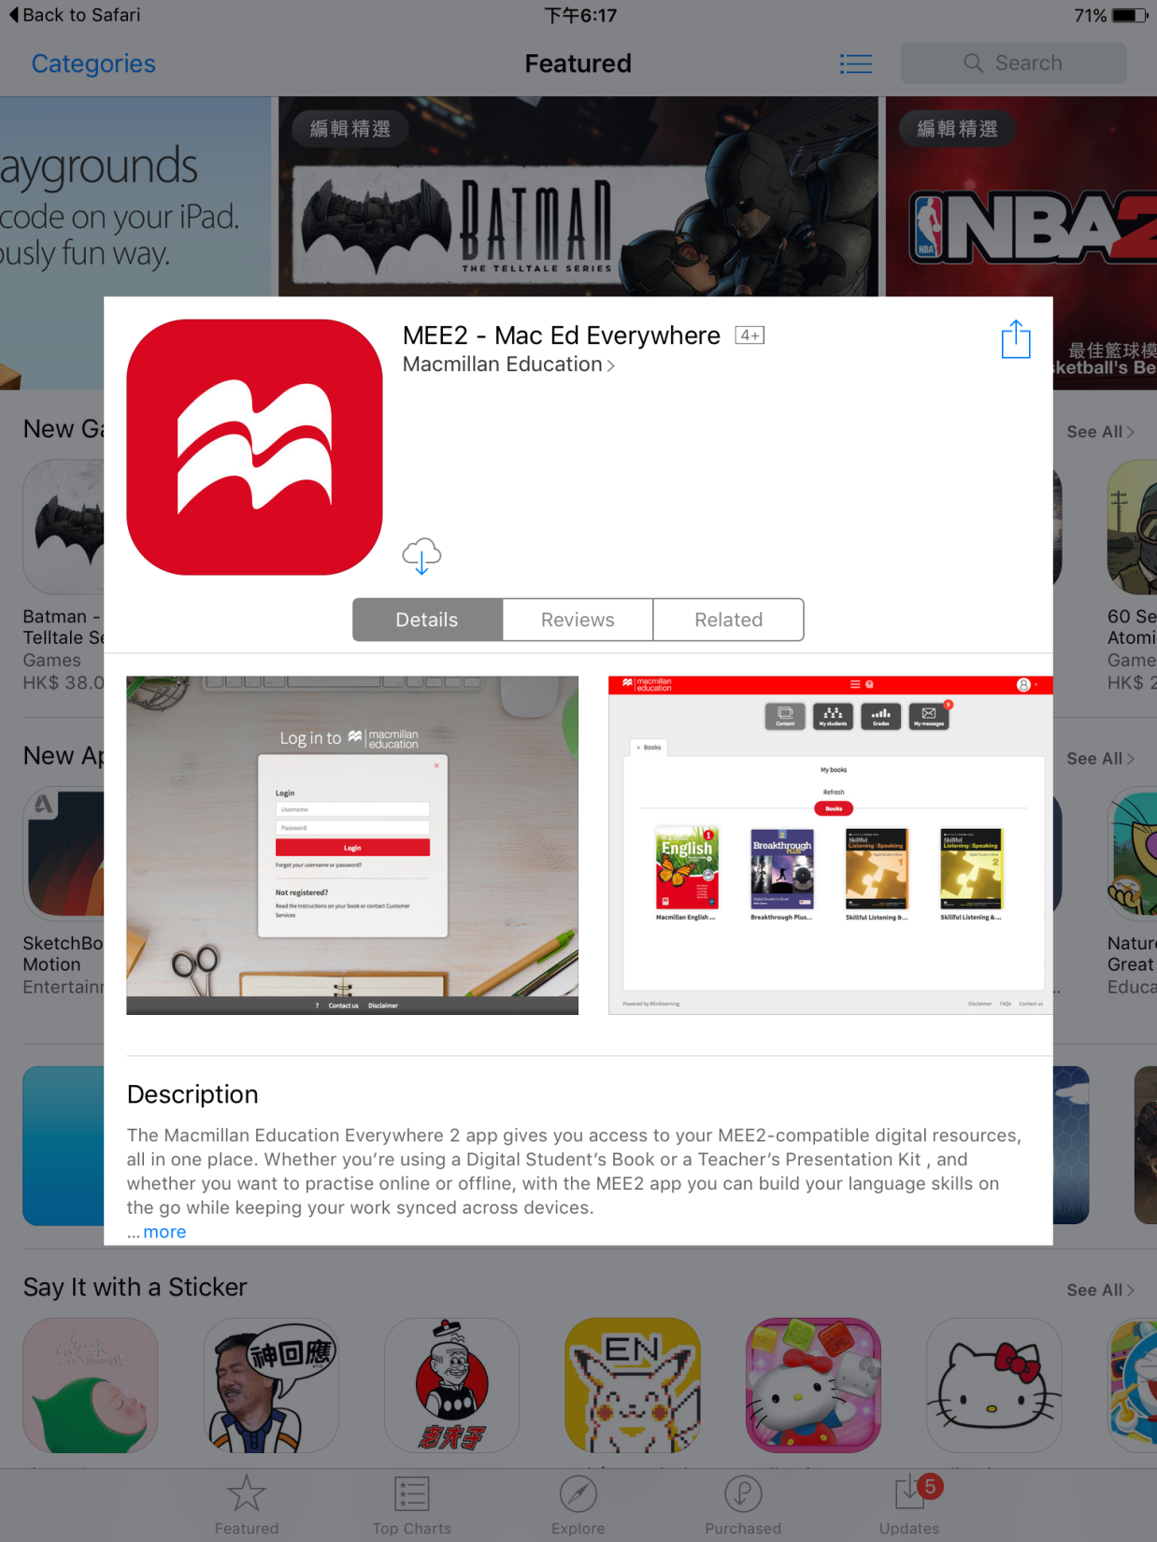
You will be taken to the App Store. Click on the download button.

Slide 9
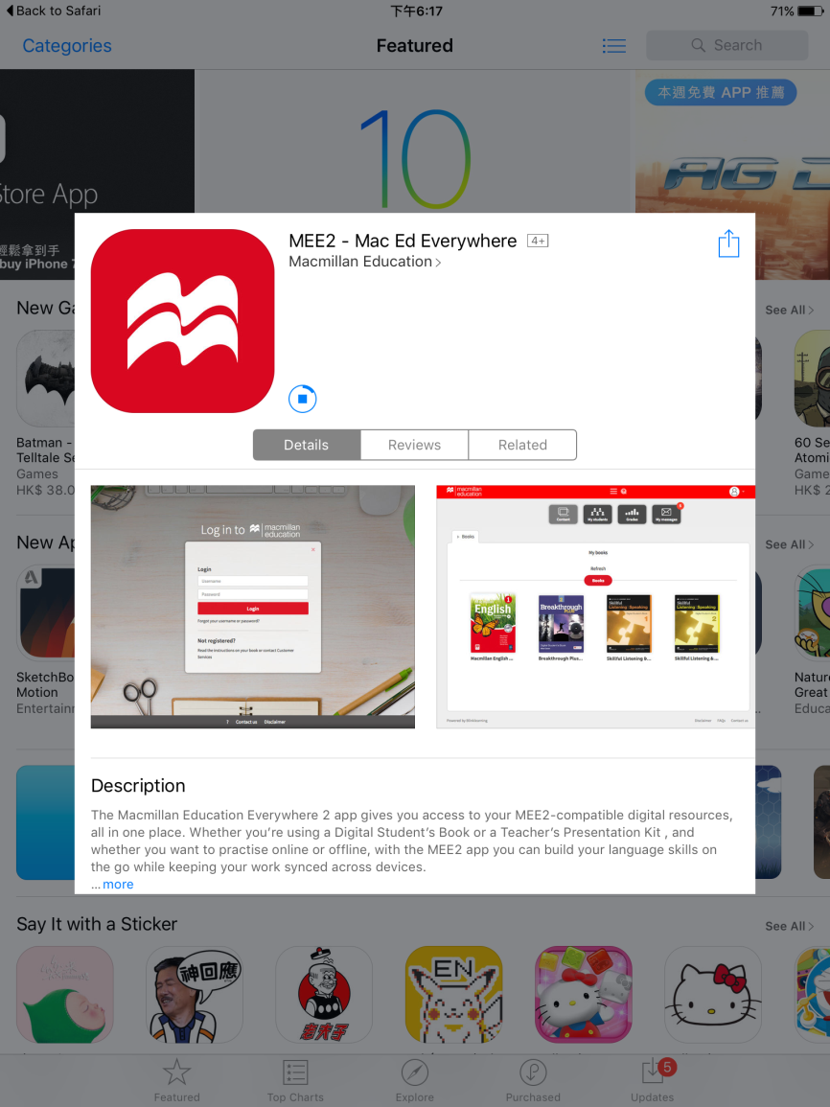
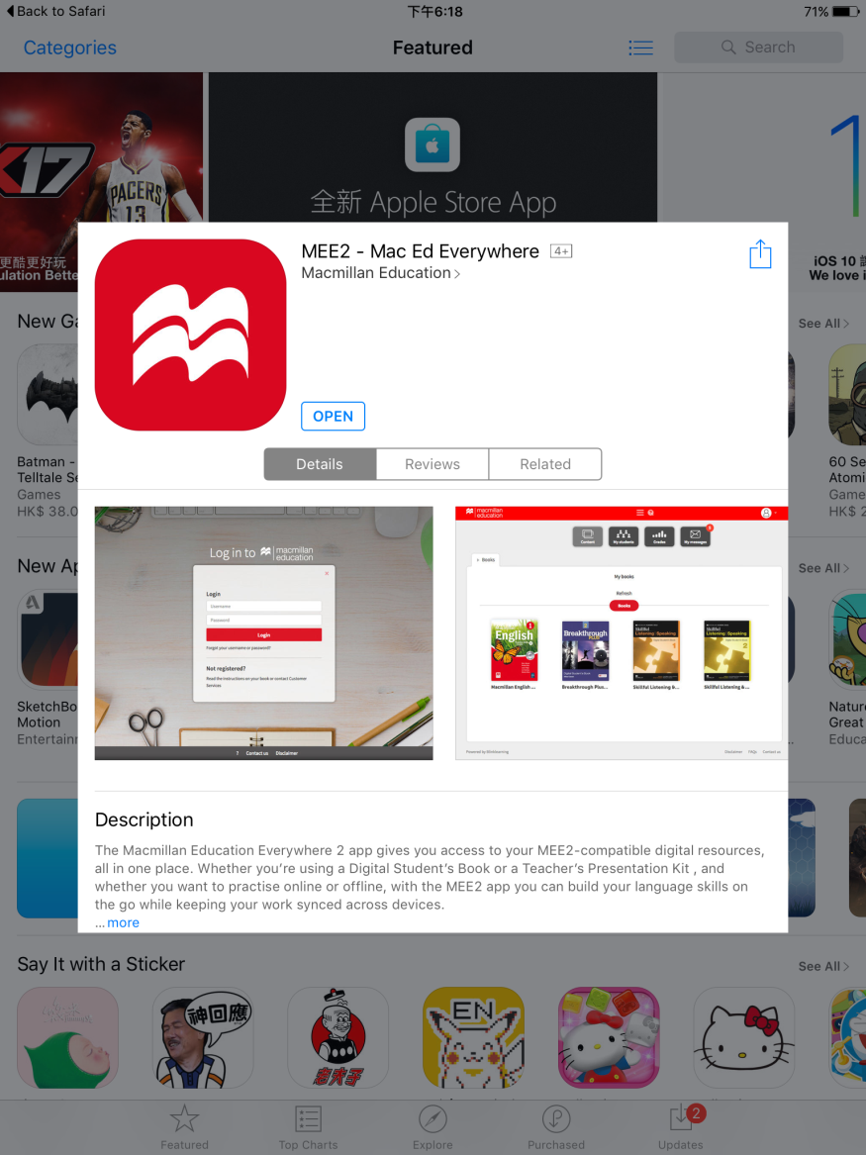
Once it has finished downloading, click: open

Slide 10
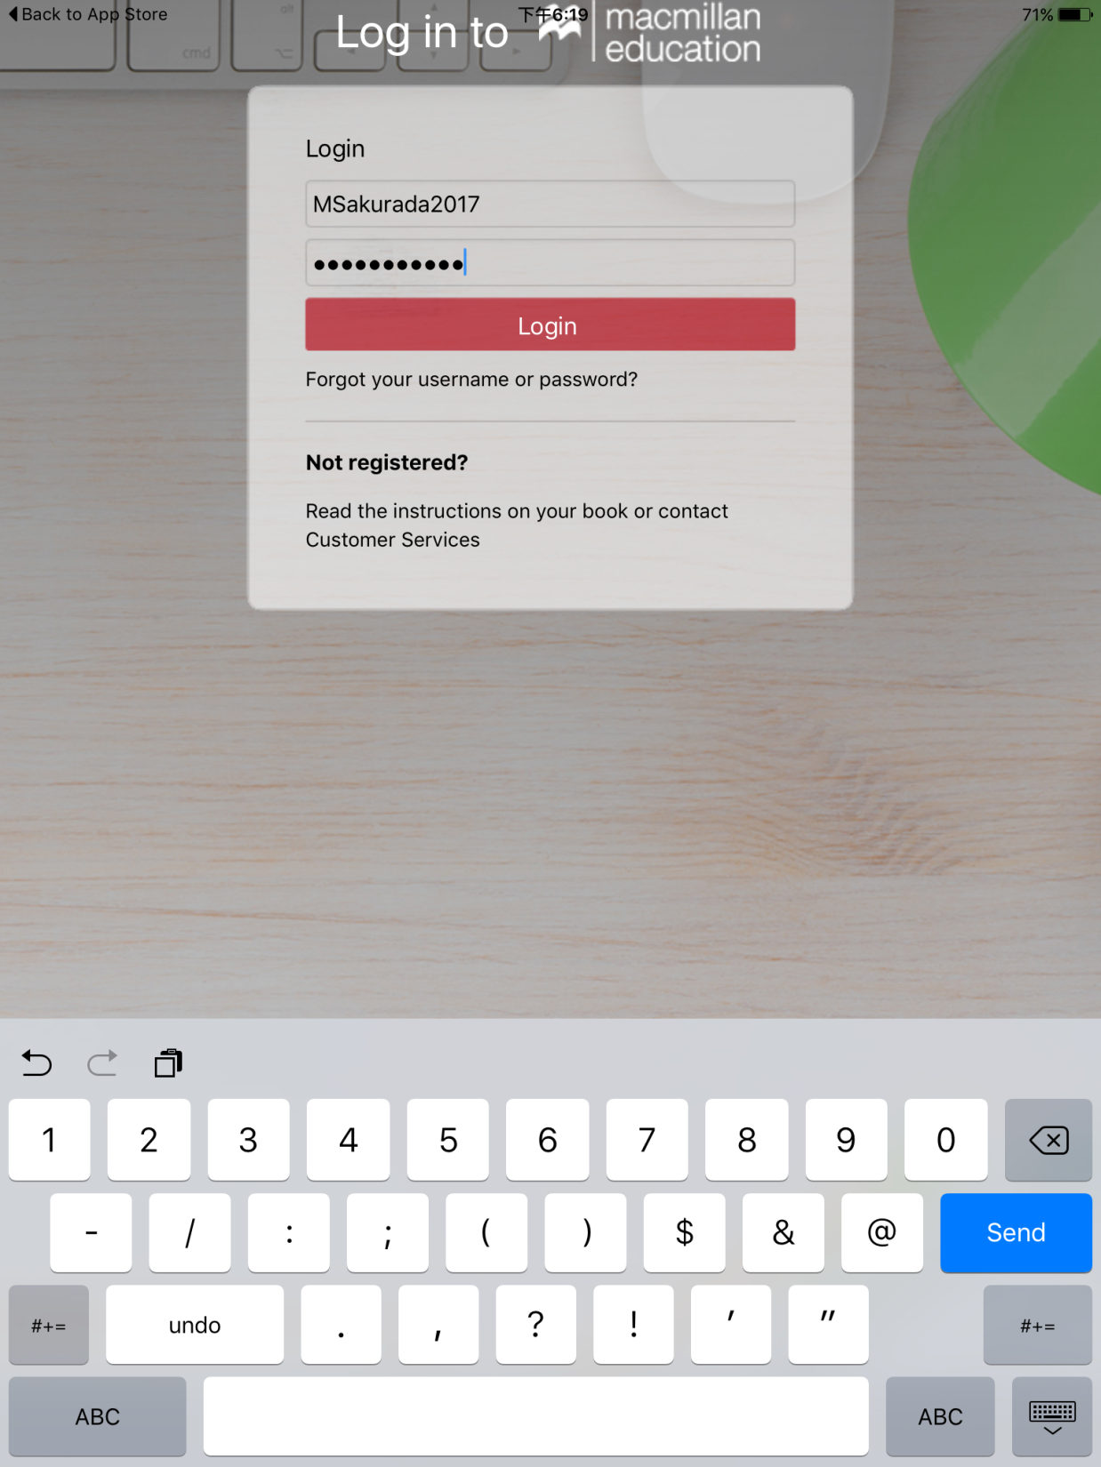
Enter your username and password that you registered with earlier. Click: login

Slide 11
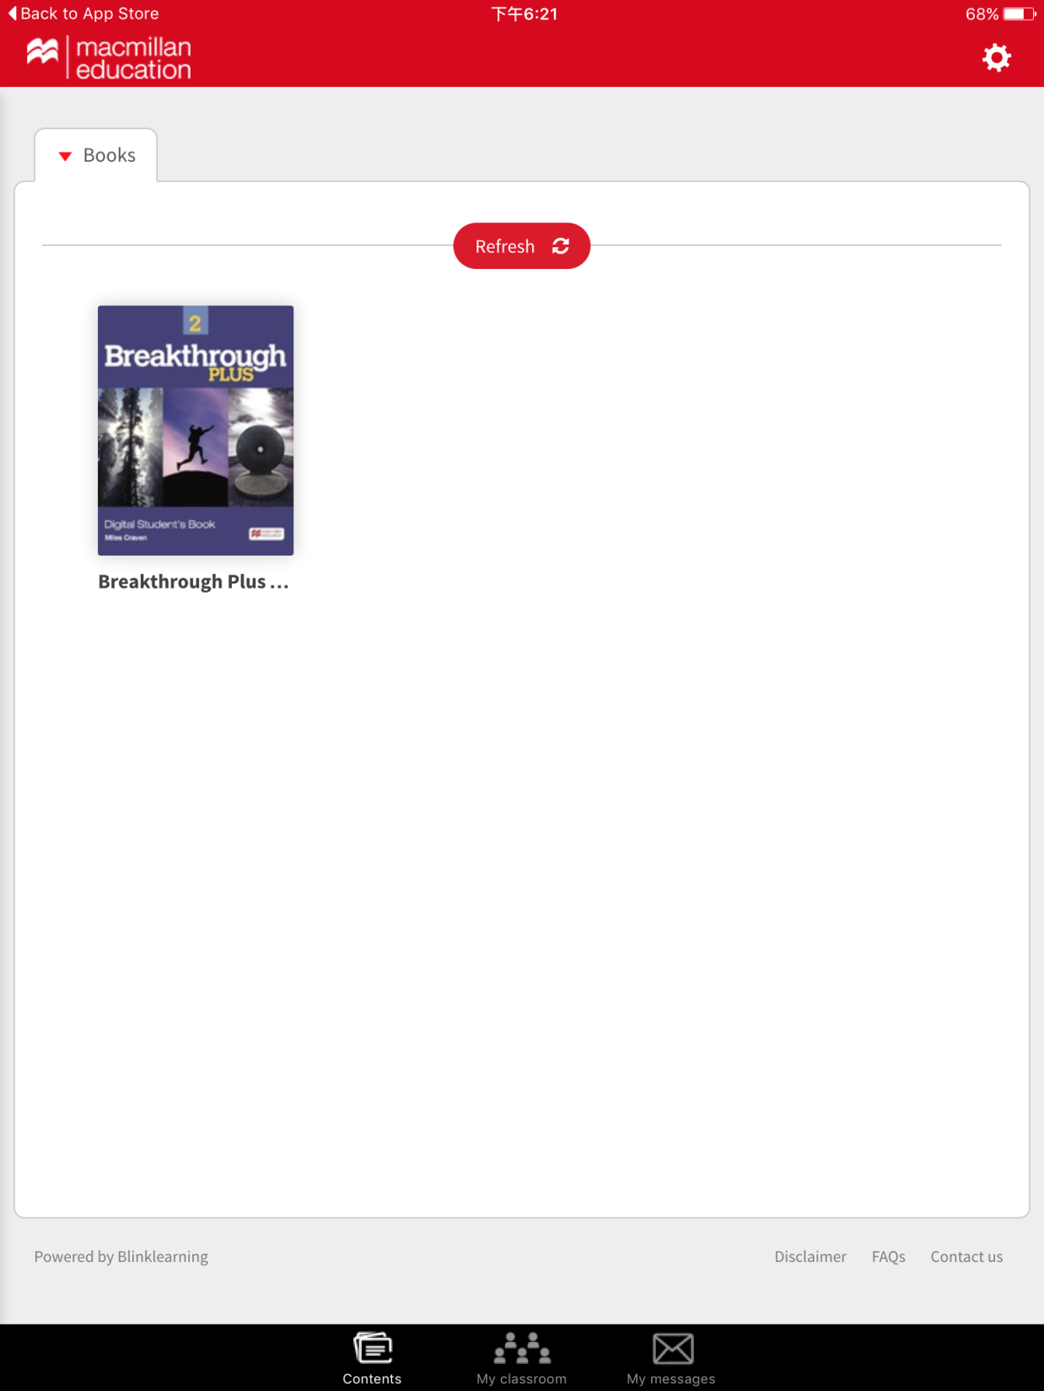
Click: My classroom

Slide 12
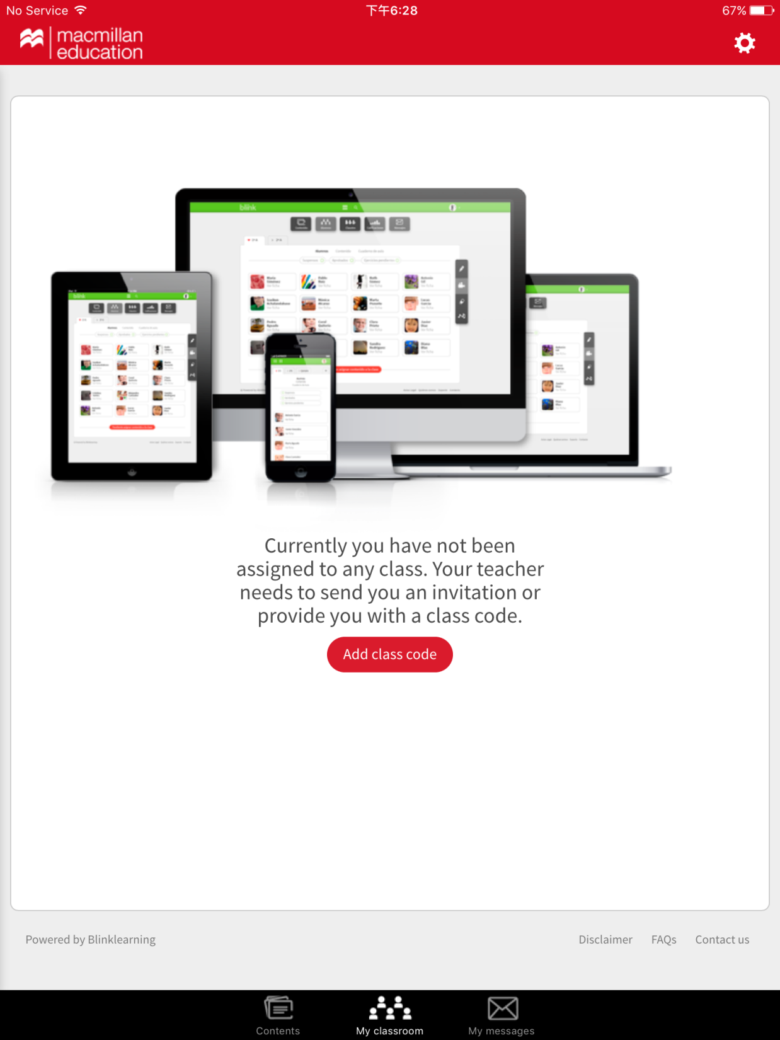
Click: Add class code

Slide 13
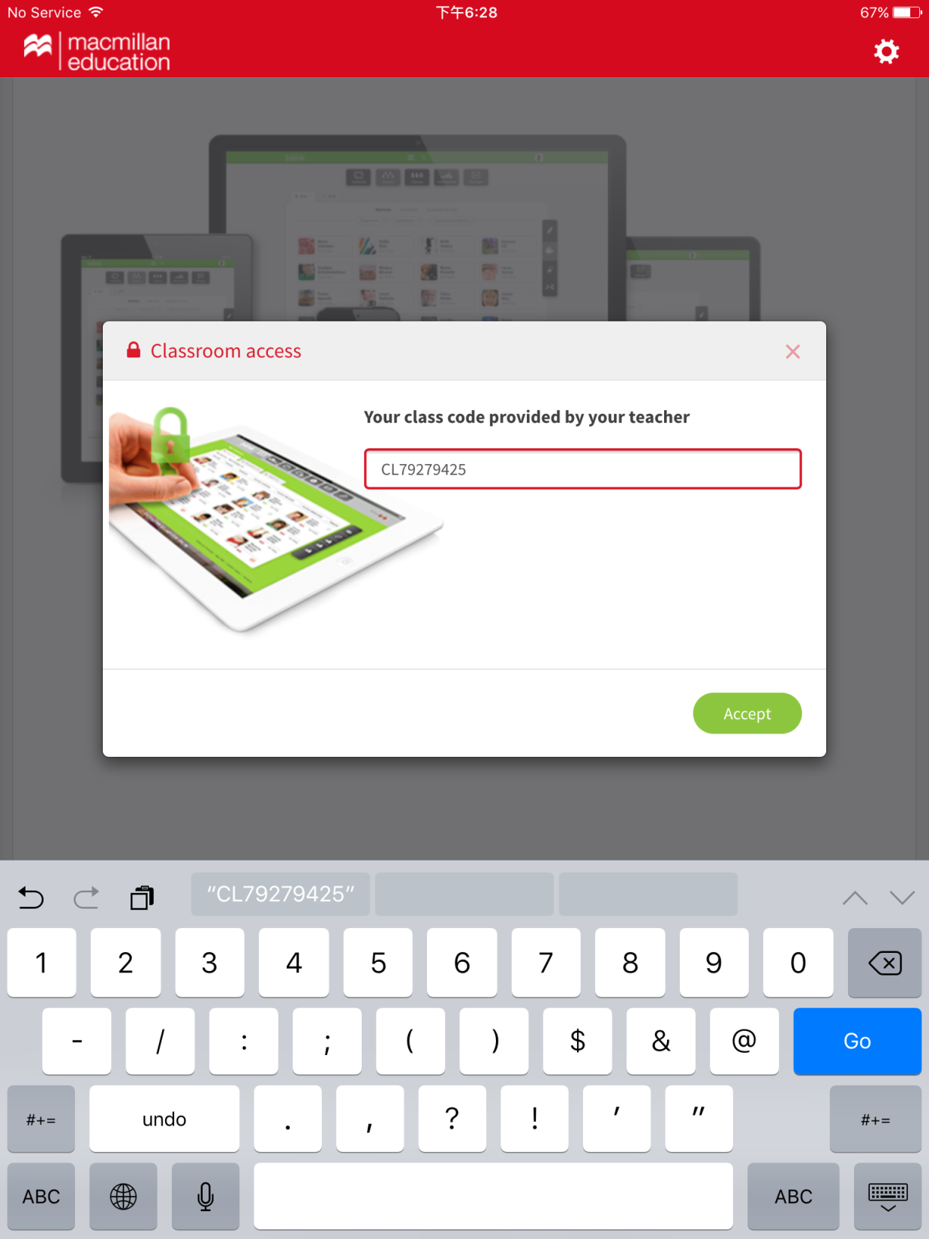
Enter the class code your teacher gave you e.g. CL79279425

Slide 14
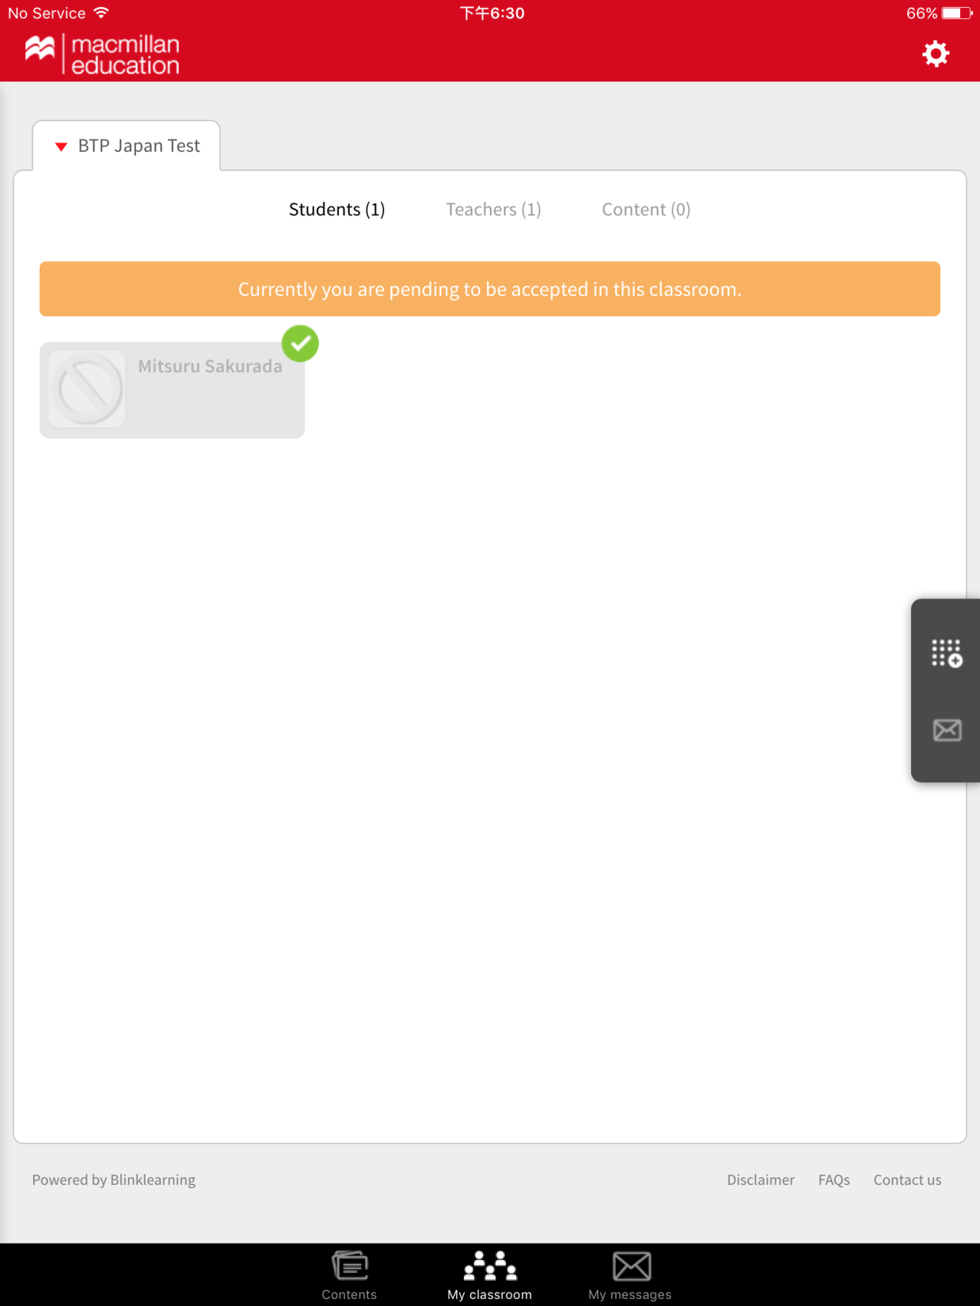
Your teacher will need to accept you into their classroom. Once they have, you will have successfully joined your teacher’s class

Slide 15
2. Working with your Digital Student’s Book

Slide 16
To access the DSB click: Contents

Slide 17
Click on the book

Slide 18
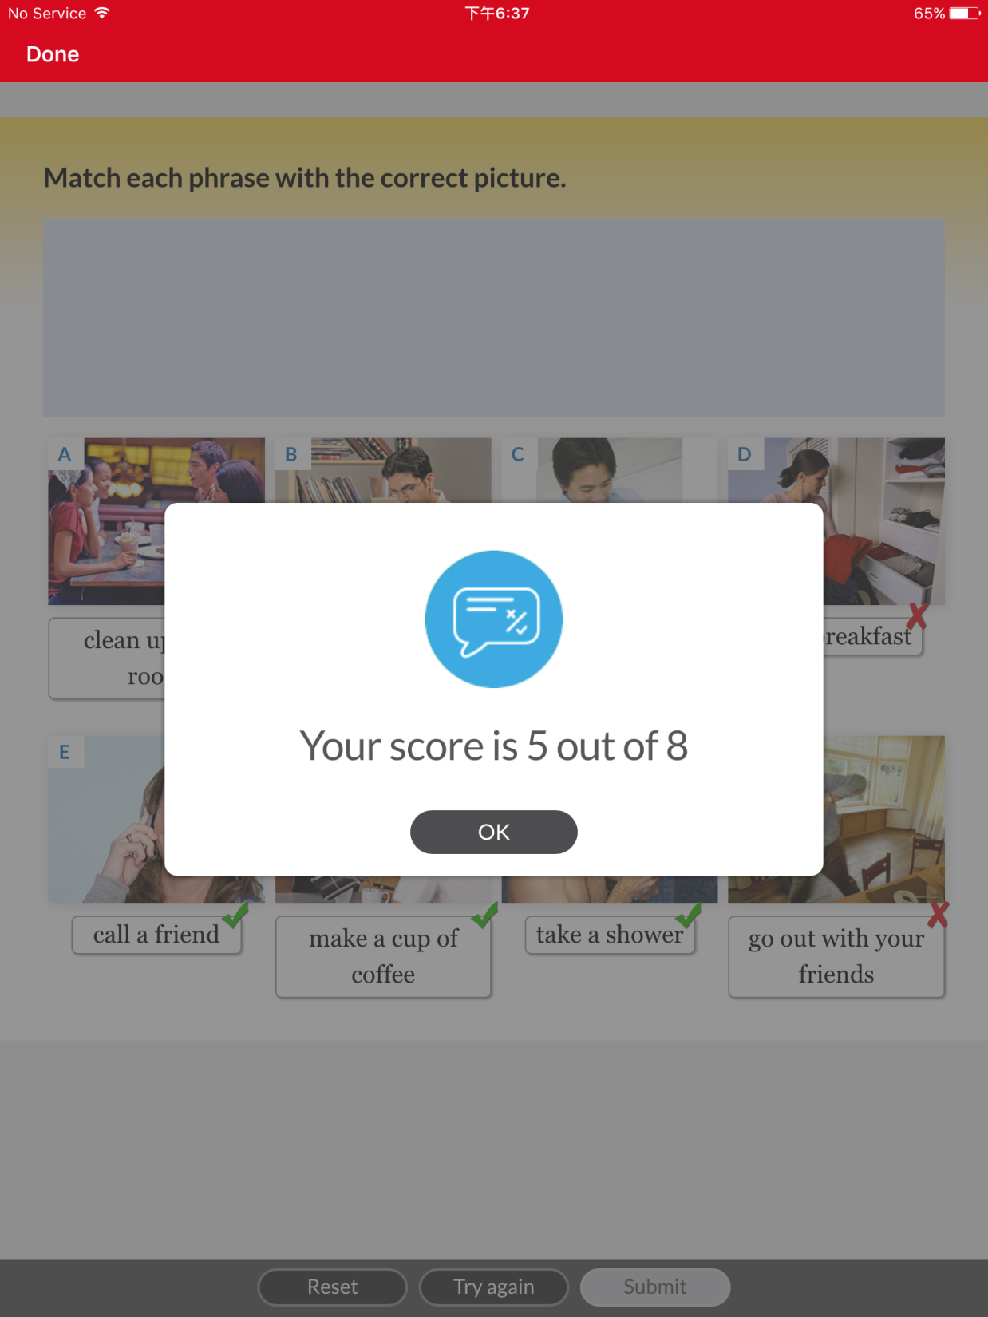
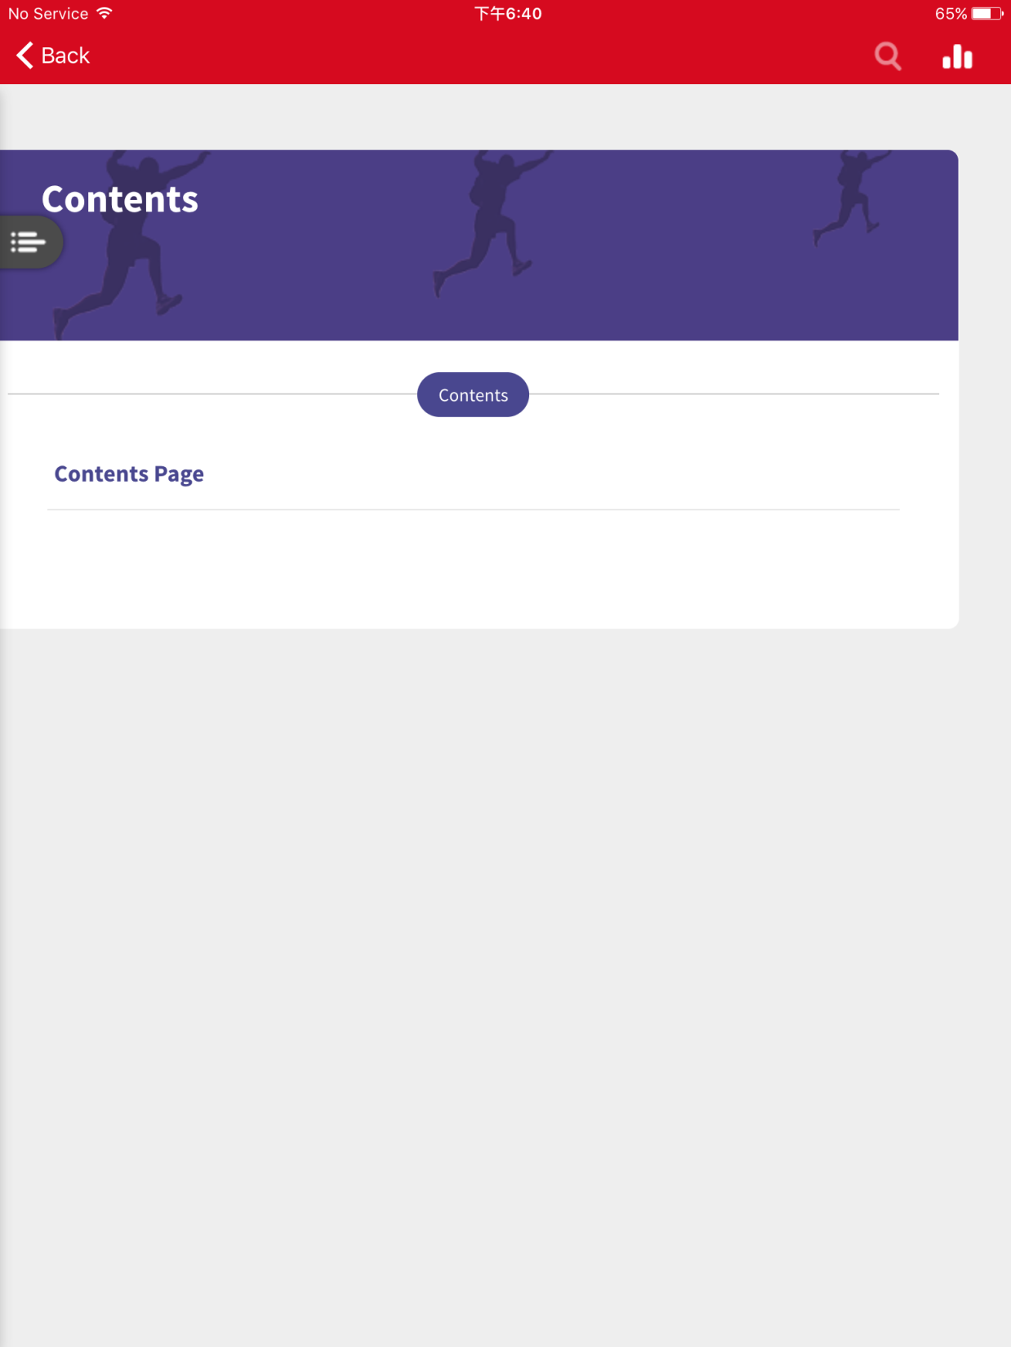
Click on this button

Slide 19
Click on a chapter from the contents

Slide 20
Turn the pages by swiping

Slide 21
Click on the buttons to listen to the conversations and do the activities

Slide 22
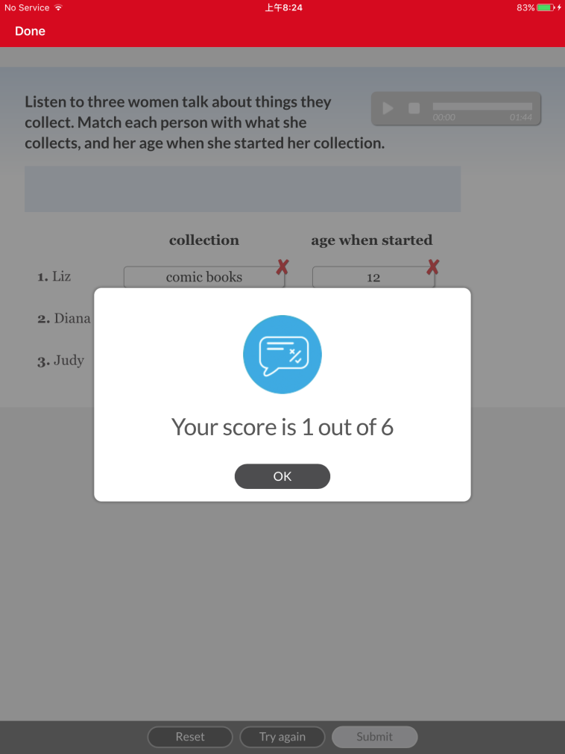
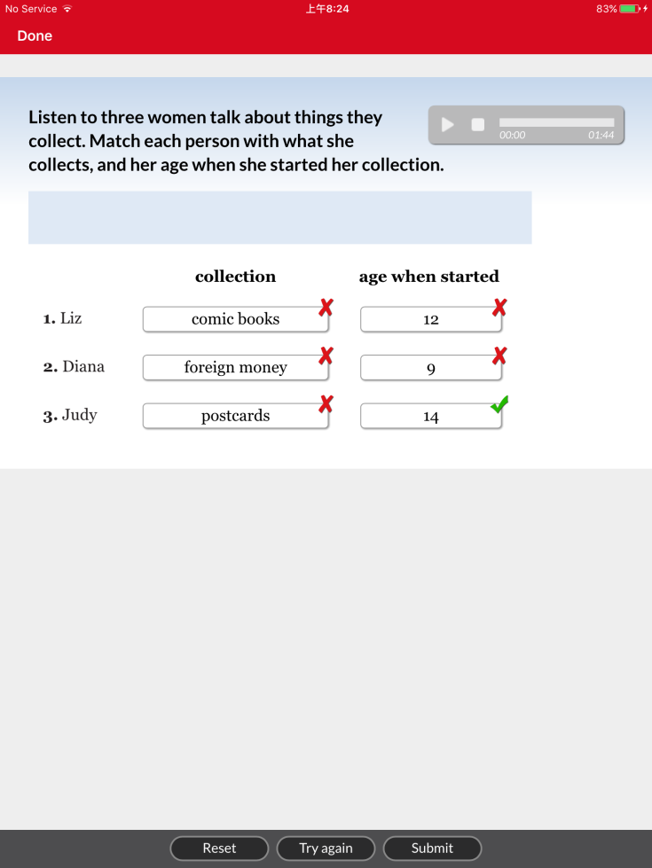
Complete the exercise and click on submit to see your score
You can reset or try again

Slide 23
Click on the button to watch the video

Slide 24
3. Sending and replying to messages

Slide 25
To send or reply to a message to your teacher, click: my messages

Slide 26
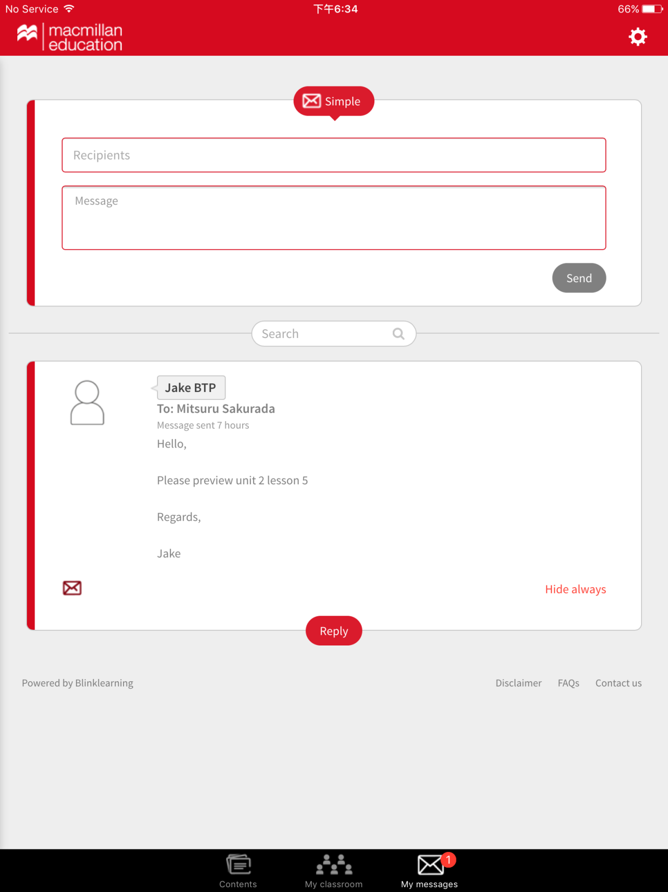
To send a message to your teacher, enter your teacher’s name and the message
To reply to your teacher’s message, click reply

Slide 27
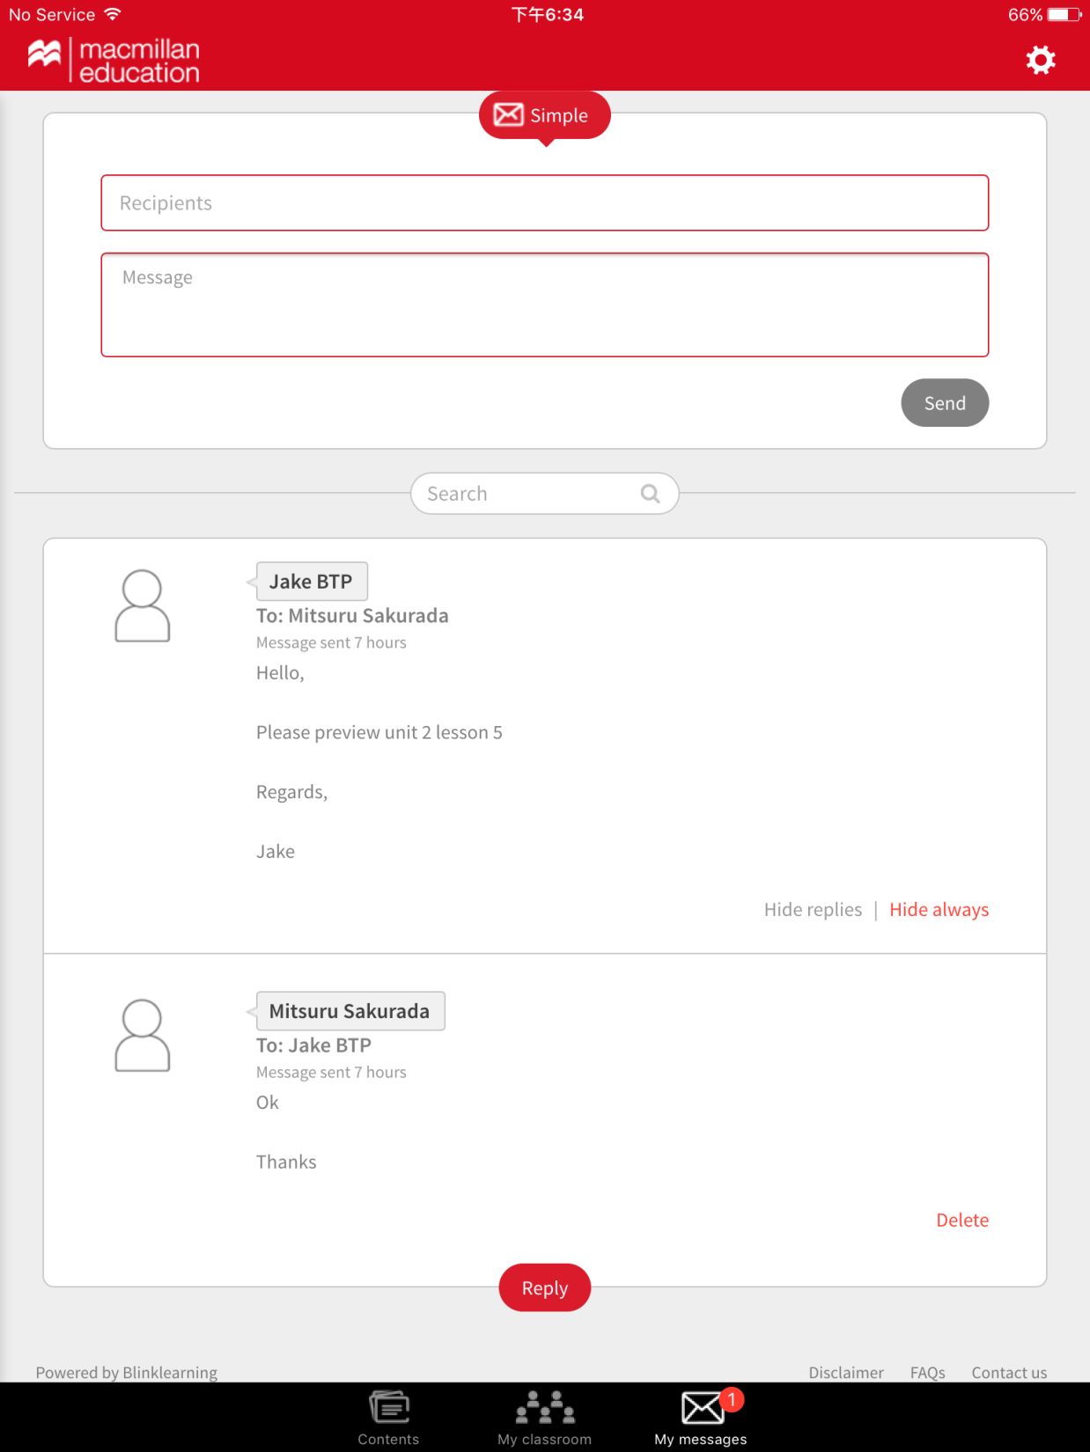
You will see your sent message

